Slide 1

Reframing Aging and Disability
Notes:
This PowerPoint has been designed with accessibility standards in mind. If you make any edits to the content, please ensure accessibility is maintained. If you have any questions about accessibility, please reach out to the project management team.

Slide 2
Who
People and Process

Slide 3
About Us
Our vision
is a Wisconsin where everyone, at every age and ability, is respected, valued, supported, and belongs.
Our mission
is to advance a fair and complete story about aging and disability: one that values every person, at every stage of life, and every ability. Through reframing our communication and expanding our mindsets, we improve quality of life for all of us.
is to end ageism and ableism in Wisconsin.
Notes:
We do this by:
• Advancing proven communication strategies and education
• Working across systems to build awareness, transforming how people think and communicate
• Advocating for programs and services that promote health and well-being across the lifespan
• Facilitating conversations which create space for learning and practicing reframing
• Creating community to sustain momentum and cultivate resources

Slide 4



Who We Are
Project management team
Advisory committee
Champions newsletter (https://wiha.wufoo.com/forms/w152jg3f0s6pwd6/)
Community of practice (4th Wednesday of the month from 2–3 pm)
Notes:
Advisory Committee: 42 members
Champions List: >300
With leadership from the Wisconsin Aging Advocacy Network and the Wisconsin Department of Health Services, we are taking steps to advance effective communication strategies about aging. Part of our multi-faceted activities includes presentations and workshops from the National Center to Reframe Aging. These events will educate key Public Health and Aging Network leaders and partners about the concepts to reframe aging and teach us how to consistently apply the communications strategies as effective framers.
Achieving meaningful cultural change requires a long-term commitment, beginning with those working within the aging and disability field itself.
Roles and Responsibilities
• Project Management Team: Provide leadership and vision for the initiative as well as resources for coordination, logistical support, implementation and documentation.
• Reframing Advisory Committee: Provide input, advice, and guidance to the Project Management Team through lived experience and professional expertise via monthly meetings and ad hoc participation. Distribute relevant information through their individual networks and support spread of reframing initiative and training. Identify and share resources and opportunities for connection and spread.
• Champions’ List: Stay informed of training opportunities, remain engaged with monthly emails that offer articles, reframing examples and other learning.
• Community of Practice: Led by Project Management Team and those completing the Core Elements training. Offering a safe place for practice and advice for anyone who wants support in application of the reframing principles.

Slide 5
What
Definitions and Examples

Slide 6
Defining Ageism and Ableism
Ageism is a form of discrimination where people are mistreated based on their age. It is rooted in a lack of knowledge, prejudice, and stereotypes. Despite being a form of discrimination, ageism is often not taken seriously, and it is even considered one of the last socially acceptable prejudices. - NIH, 2024
Ableism is the discrimination of and social prejudice against people with disabilities based on the belief that typical abilities are superior. At its heart, ableism is rooted in the assumption that disabled people require ‘fixing’ and defines people by their disability. Ableism classifies entire groups of people as ‘less than,’ and includes harmful stereotypes, misconceptions, and generalizations of people with disabilities. - Access Living, https://www.accessliving.org/
Notes:
Ageism is one of the most prevalent, least recognized, and tacitly normalized forms of stereotyping and prejudice within society.
A note: Much of the material I am sharing today leans toward aging, as the content is shared from our partners at the National Center to Reframe Aging. There is significant overlap in issues and strategies for the disability community. For one, everyone is aging including people with disabilities and secondly the real decline that often accompanies old, old age is definitely concerned with ageism and ableism. I encourage us all to look for those messages that are translatable and I welcome thoughts about distinctions.

Slide 7
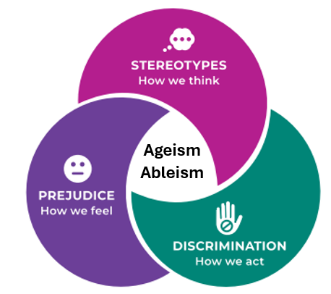
How Ageism and Ableism Show Up
On multiple levels
Interpersonal
Compassionate
Systemic/ Institutional
Self-directed
Information credit: World Health Organization
Notes:
When what we think of older adults as “frail” (our stereotype), then we might feel protective (the bubble wrap syndrome) or uninterested and from there we make decisions and act (discriminate). For example, many animal shelters and rescue organizations have age limits or guidelines for adopters, especially for older adults (over 65), though these vary widely; some limit seniors from adopting young pets due to concerns about the pet's lifespan. This is despite the fact that a succession plan would solve this concern and there are so many animals in shelters.
When people think of individuals with disabilities as “burdens” or “constantly needing help” (think-stereotype) then we may feel that it is “too much to demanding to accommodate” (feel-prejudice). This can lead to discriminatory actions, such as landlords refusing to rent to people with disabilities (act-discrimination) because they assume the person will cause damage, won’t be able to pay rent, or will need “too many accommodations.” These decisions ignore fair housing laws and overlook the fact that most accommodations are simple and low cost.
Interpersonal: Aren’t you too old to wear that?! You look great for your age!
Compassionate: Elderspeak – honey, sweetie, etc.
Systemic/Institutional: mandatory retirement
Self-directed: I’m too old for that! It’s just a normal pain that comes at my age.
Notes for OTs or other helping professions (like Hospice): As OTs, people come to you when they are facing challenges. It can be easy to start creating an internal image of older people (injured, disabled, in need of help). This bias is affirmed every time you see another older patient. It is important to recognize this bias and know that there are many older adults that are NOT seeking care or dealing with injury, decline, etc. Also, it is important to recognize that those that are seeking care are so much more than their current situation and should not be defined by their need for assistance.
• We should never assume that some can or cannot do something because of their age. Each person should be treated as an individual. Functional ability is sourced in diagnosis and SDOH -- not age
• In reference to internal ageism, many (if not all) of the patients they see will have some level of internalized ageism, which may impact their motivation for therapy. OTs (and other medical professionals) have a great opportunity to educate their patients about ageism and the impacts of positive thoughts about aging. There is often time during appointments (while exercises are happening) for these conversations and can improve patients’ self-worth AND potential for success within therapy. How that education is delivered is critical. How do we impart new information without an underlying tone of “you’re doing it wrong”. MI principles here are helpful. What do you know about ageism? How do you experience it? Can I share somethings I’ve been learning?
Specifically, experts recommended the following solutions:
1.
Workplace policies should be restructured to allow people to work longer and with a greater degree of flexibility. These accommodations should extend not only to older adults, but to those in elder caregiving positions as well.
2.
Public spending must be made more efficient to accommodate the aging demographic shift and provide for the health care and retirement income security needs of older adults.
3.
Patterns of ageist discrimination need to be addressed so that older Americans can fully contribute to our civic and economic life.
4.
Alongside other policy initiatives, Social Security must be strengthened to ensure retirement income security.
5.
The nation needs to expand a well-prepared health care and geriatric workforce, and address the growing need for long-term care.
6.
Better institutional and social supports must be provided for the more than 40 million people in the United States who provide unpaid care to family members and loved ones.
7.
Greater investments must be made in research to better understand both the aging process and the implications of an aging population for our society.

Slide 8
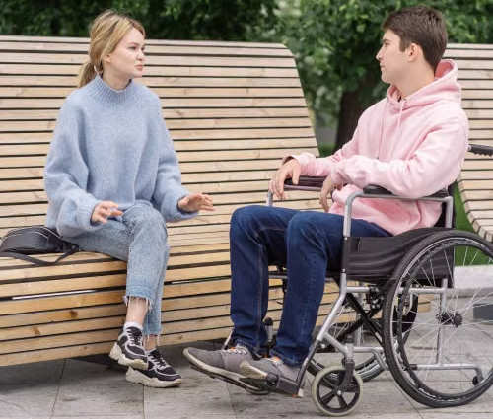
Everyday Ageism and Ableism
Routine, socially acceptable forms of ageism and ableism are pervasive
Internalized 81.2%
Media
65.2%
Interpersonal 44.9%
Refusing to use a cane, wheelchair or hearing aid out of pride or embarrassment.
Only 25% of films feature at least one female character over 50 who is essential to the plot and is portrayed without reducing them to ageist stereotypes.
Speaking in a loud, slow, exaggerated, or
sing-song voice.
Notes:
“A 2022 study found that for adults age 50-80 93.4% regularly experienced one or more forms of ageism.
Citation: Allen, J.O., Solway, E., Kirch, M., Singer, D., Kullgren, J.T., Moise, V., & Malani, P.N. (2022) Experiences of everyday ageism and the health of older US adults. JAMA Open Network 5(6), e2217240
2022 study of 2,035 adults ages 50-80 found 93.4% regularly experienced one or more forms of “everyday ageism”
Gena Davis Institute Beyond the Stereotypes: The Reality of Aging Women in Films page - Geena Davis Institute and the 2020 report “Frail, Frumpy and Forgotten” from the Geena Davis Institute (with USC Viterbi School of Engineering and TENA)

Slide 9
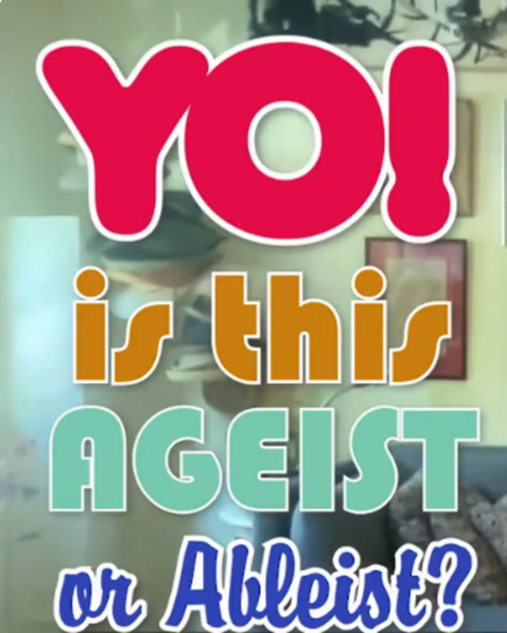
Why distinction matters
Ageism and Ableism
Notes:
BEFORE the next slide – We need to qualify that many of the slides lean toward the ageism side of the equation. That is partially because we have spent the last year working with the National Center to Reframe Aging and partially because there is less complimentary content in the disability literature.

Slide 10
The Intersection of Age and Disability
“Our findings suggest both a need to explore disability identity issues among older adults as well as the importance of encouraging health care providers and systems to ask about and provide disability-related accommodations for older adults and others with functional limitations.”
Michelle Meade, Ph.D., who worked with the poll team and is the founding director of the U-M Center for Disability Health and Wellness.
19% of people age 50 and over identify as a person with a disability
50% of older adults may legally qualify as a person with a disability
Notes:
19% of people age 50 and over identify as a person with a disability, according to findings from the National Poll on Healthy Aging, based at the University of Michigan Institute for Healthcare Policy and Innovation.
But, the poll suggests, half of older adults may legally qualify as a person with a disability because of a physical or mental condition, and thus be entitled to protections and accommodations, even if they don’t identify as disabled. This may be especially true among those aged 65 and up.

Slide 11
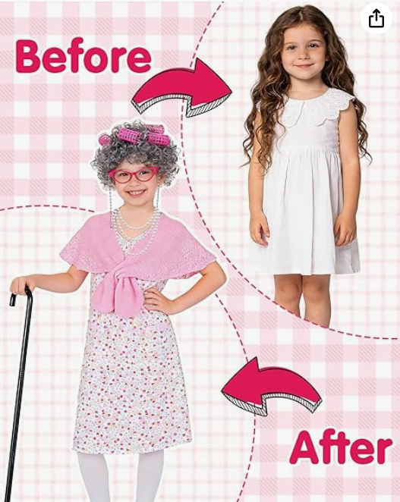
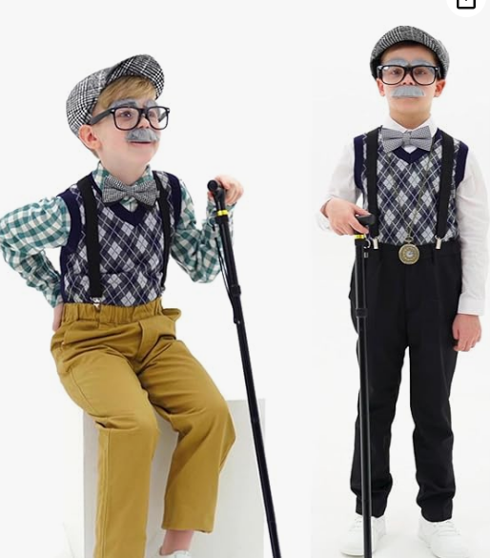
Learning Early: 100th Day Of School
Notes:
Let’s talk about how ageism and ableism show up. It shows up at the very beginning and is reinforced all life long. What do you see in these pictures that reinforces age stereotypes? What do you see in these pictures that reinforces disability stereotypes?

Slide 12
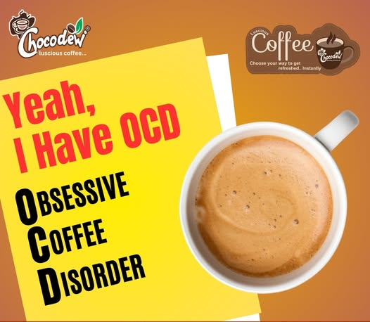





In Advertising
Notes:
Ask the audience to identify which are example of ageism and which are examples of ableism and which are both.
It also shows up in advertising: underrepresentation, stereotypical portrayals (frail, lonely, struggling with technology), strong focus on anti-aging
Ableist advertising: token person with a disability, inspiration trope (inspirational simply for existing with a disability), medicalization (focusing on the disability not the person), poking fun at the disability (OCD ad, Sheldon in Big Bang)
Presenter can use this slide to engage – audience. Which images are ageist? Which images are ableist OCD, Grandma (intellectually impaired), ?

Slide 13
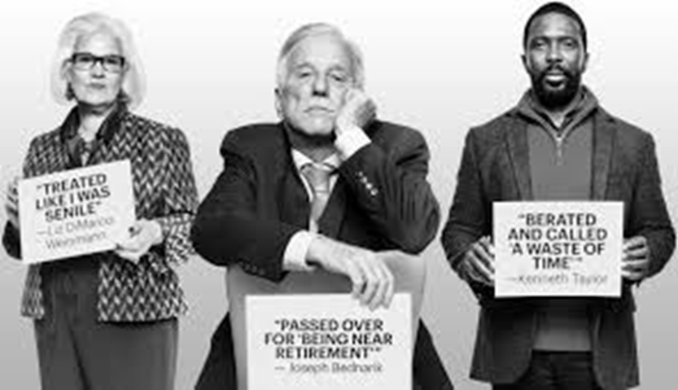
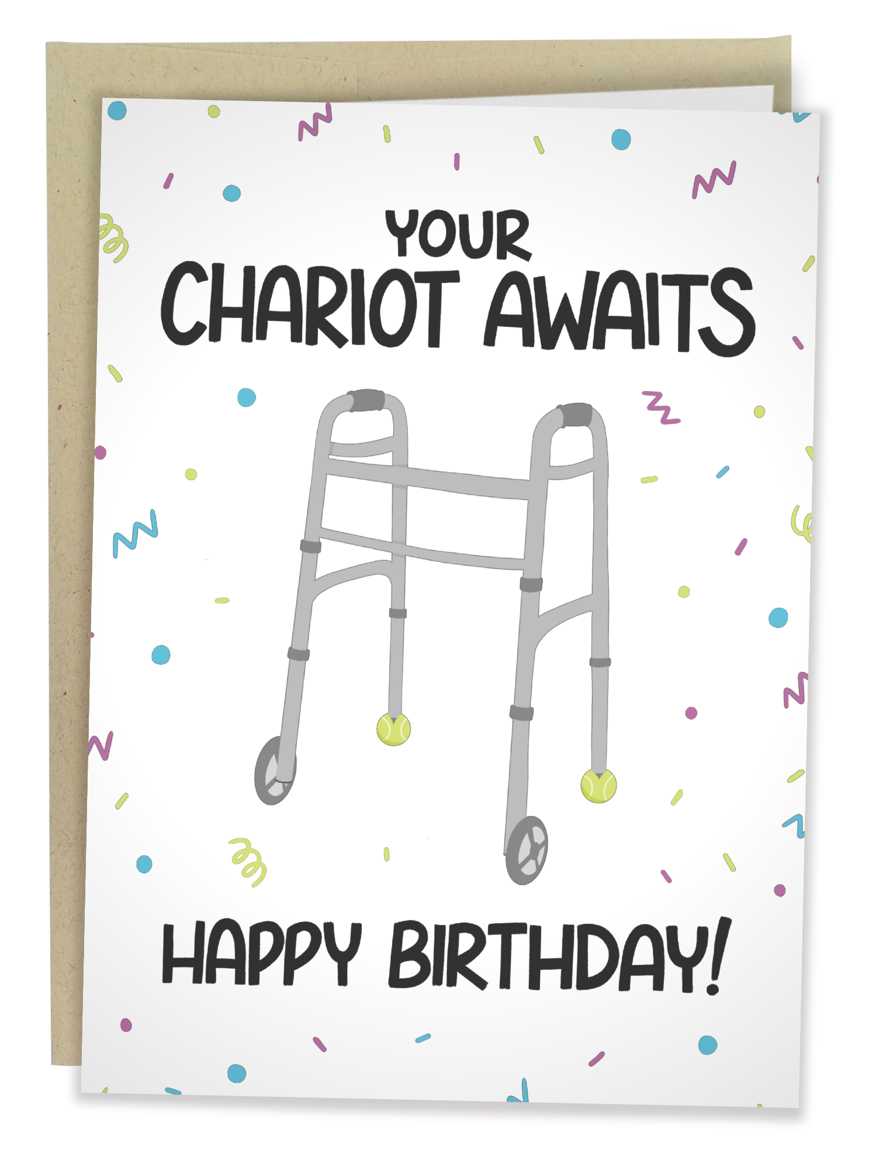
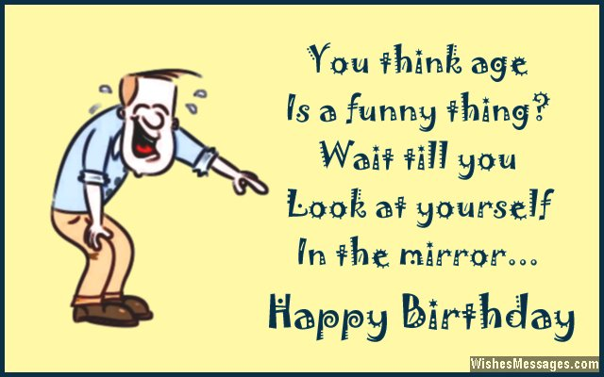
In Work and Play
Notes:
It shows up in “Funny” greeting cards. “Funny” is a sneaky way to normalize negative stereotypes.
Would the cards be considered funny if they were minimizing another group of people?
Ableism – inaccessible work spaces, documents, or social gatherings; not believing someone has a disability because "they don't look disabled" (invisible disabilities)
Treated like I was Senile
Passed over for being near retirement
Berated and called a waste of time

Slide 14
In Healthcare
Only 10% of medical schools require geriatric rotations while 96% require pediatric rotations.
Fewer than half of geriatric psychiatry fellowships filled each year.
9.0% of social workers identified aging as specific field of practice
A third of clinical trials funded by the NIH between 1965 to 2015 had arbitrary upper age limits without a clear explanation
The historical approach to disability emphasizing diagnosis and treatment. Yet many health disparities experienced by people disabilities are created by inaccessible environments, discriminatory attitudes, and systemic barriers -- not by disability itself
Notes:
Funding Shortfall: Geriatrics Workforce Enhancement Program (GWEP) grants were cut from an expected \(\$41.8\) million to \(\$27.5\) million, causing significant instability for university and hospital training programs. Proposed 2026 Cuts: The proposed budget for fiscal 2026 aims to eliminate GWEP and other Health Resources and Services Administration (HRSA) programs to save taxpayer funds. Workforce Impact: These cuts threaten programs that train over 70,000 people annually, worsening an already severe shortage of geriatric providers (currently fewer than 12 geriatric physicians per 100,000 older adults).
3rd bullet: Older adults left out of clinical research trials | Michigan Medicine,
4th bullet citation: Equitable inclusion of people with disabilities in clinical trials: a scoping review – PMC, Jo G, Castro F, Cerilli C, Varadaraj V, Rosman L, Kamenov K, Barrett D, Swenor B. Equitable inclusion of people with disabilities in clinical trials: a scoping review. BMJ Open. 2026 Feb 4;16(2):e108550. doi: 10.1136/bmjopen-2025-108550. PMID: 41638736; PMCID: PMC12878309.

Slide 15
Why
Widespread and Harmful

Slide 16
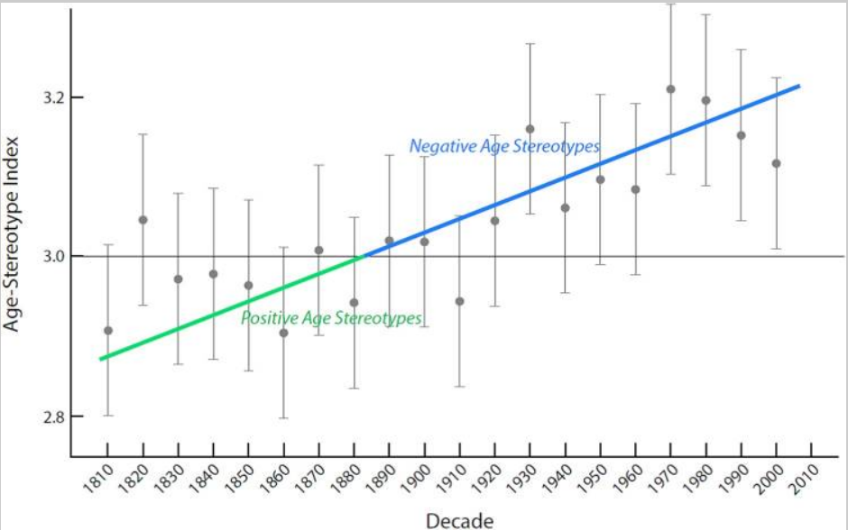
The Trend
Notes:
“Because the problem is only getting worse”
According to the trend line, age stereotypes were positive from 1810 to 1879, became neutral in 1880, and have become increasingly negative in the following decades.
Medicalization of aging (β = .03, p <.0001) was a significant predictor of the negativity of age stereotypes.
The horizontal line indicates the neutral point in the Age-Stereotype Index, with scores lower than three (before 1880) indicating average positive-age-stereotype scores and scores greater than three (after 1880) indicating average negative-age-stereotype scores.
This study applied computational linguistics to the recently compiled Corpus of Historical American English (COHA), a database of 400 million words that includes a range of printed sources from 1810 to 2009.
Citation: Ng R, Allore HG, Trentalange M, Monin JK, Levy BR. Increasing negativity of age stereotypes across 200 years: evidence from a database of 400 million words. PLoS One. 2015 Feb 12;10(2):e0117086. doi: 10.1371/journal.pone.0117086. PMID: 25675438; PMCID: PMC4326131.

Slide 17
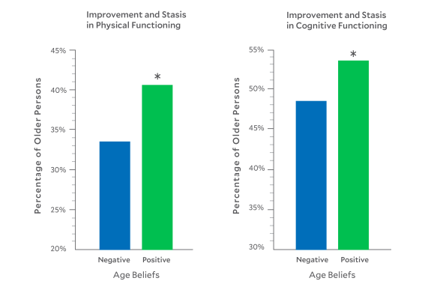
Another Misconception?
Cognitive and Physical Improvement
Notes:
A study published 4 March 2026 demonstrated that the predominant narrative of aging as a time of inevitable and universal decline needs to be reconsidered. Yale researcher Becca Levy discovered that 45.15% of the participants, who were 65 years and older, showed improvement in cognitive and/or physical function over a period of up to 12 years from baseline. If this finding was extrapolated to the entire US population, it would suggest that more than 26 million older persons are experiencing an improvement in functioning.
Citation: Levy, B. R., & Slade, M. D. (2026). Aging Redefined: Cognitive and Physical Improvement with Positive Age Beliefs. Geriatrics, 11(2), 28. https://doi.org/10.3390/geriatrics11020028

Slide 18
More “Why”
These often subtle “isms” have created long-term unhealthy social influences on policy development, funding and people.
Older adults who associated “normal aging” with cognitive and physical health problems are less likely to report that they’d discuss these health concerns with their doctor.
Those who attribute their ailments to old age, have significantly HIGHER levels of arthritis, hearing loss and heart disease than those who attribute these disabilities to other causes.
People with disabilities who internalize ableism are less likely to seek accommodations, preventive care, or employment opportunities.
When disability is viewed primarily as an individual deficit, rather than a systemic issue, policies and funding often prioritize "fixing" the individuals instead of removing barriers.
(Levy et al., 2002; Bogart, 2014; Iezzoni, 2011)
Notes:
People who have positive associations with aging are 44% times more likely to recover from a disabling condition. (Be cautious that the way this is articulated does not make it sound like disability is a "bad" thing or something that NEEDS to be recovered from in order to age successfully.)
​The earlier and more negative your self-stereotypes of aging, the greater your risk of earlier cardiovascular events​
​And particularly relevant for us - People who negatively believe – “As I age, health problems are inevitable”, will engage in fewer preventive behaviors.
Inaccessible healthcare facilities can lead to medical errors and delayed care.
Reduced employment opportunities and educational segregation can limit financial independence.

Slide 19
How Beliefs Shape Us
Positive age beliefs:
  reduce stress
  increase quality of life
  increase longevity (by 7.5 years!)
(Levy et al., 2002; Bogart, 2014; Iezzoni, 2011)
Positive disability identity and reduced self-stigma:
  strengthen psychological well-being
  increase self-advocacy and accommodation use
  increase healthcare engagement and community participation
Notes:
Older individuals who had more positive self-perceptions of aging at baseline were significantly more likely to practice preventive health behaviors over the next two decades.
Positive disability identity/disability pride and reduced self stigma leads to greater life satisfaction and adaptation to disability (Kathleen Bogart, 2014)

Slide 20
How
We can do something about it!

Slide 21
A Good Place to Start
Implicit bias refers to the attitudes or stereotypes that affect our understanding, actions, and decisions in an unconscious manner.
(The Kirwan Institute for the Study of Race and Ethnicity)
Simply being aware of our implicit bias reduces the “ism”.
(Busso et al., 2019)
Notes:
It starts with me! Being aware of our own internal bias allows us to make a new decision to think a new thought or speak differently.

Slide 22
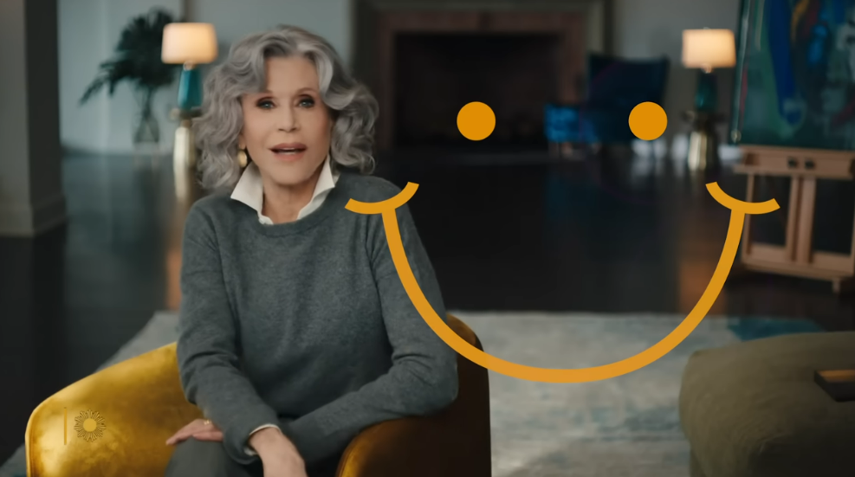
Positive Age Beliefs
Notes:
Jane Fonda with a secret of aging well (4m 21s) https://youtu.be/KQXAJRY6XYs

Slide 23
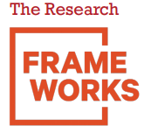
FrameWorks Institute
Nonprofit think tank with the mission to advance the nonprofit sector’s capacity to reframe social issues.
Conducts original, scholarly research on the communications aspects of social and scientific issues.
Used quantitative and qualitative methods (with a sample size of 12,185 people) to develop empirically supported messaging strategies for advocates and communicators working in the aging space.
This research conducted by FrameWorks Institute was distributed for educational purposes by the National Center to Reframe Aging
Notes:
FrameWorks provided the research foundation for NCRA’s training.

Slide 24

National Center to Reframing Aging
The nation’s leading organization and trusted source for proven communication strategies and tools to effectively frame aging issues.
Cultivating an active community of individuals and organizations to spread awareness of implicit bias toward older people and influence policies and programs that benefit all of us as we age.
Led by The Gerontological Society of America (GSA), the National Center acts on behalf of and amplifies efforts of the ten Leaders of Aging Organizations.
Notes:
Now we have the Tools!
With the advent of evidence-based framing strategies through the National Center to Reframe Aging (NCRA) and the Frameworks Institute, industry leaders and advocates see an opportunity to make a meaningful impact that advances age-inclusive policies.
Unfortunately, there is not National Center to Reframe Disability. So, we are going to have to do it ourselves.

Slide 25
One Thing Leads to Another
Changing our communications through intentional framing strategies
Changes the way we talk about aging and disability
Which changes our thinking
Which can lead to beneficial policy and systems change.

Slide 26
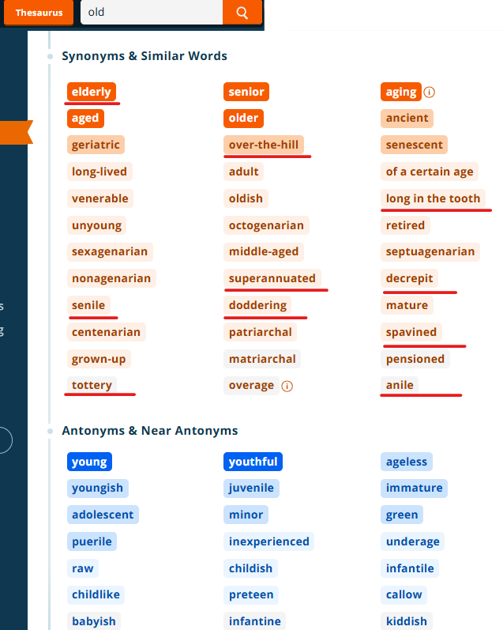
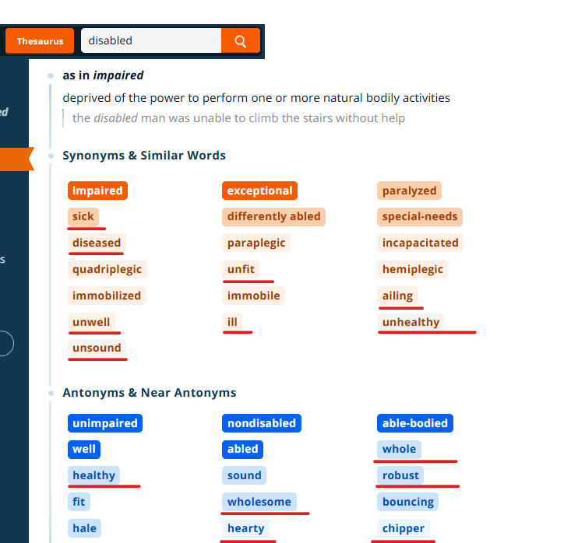
Words Matter
Notes:
“Dictionary provides a helpful pulse on our social constructs” – Point out underlined words.

Slide 27
Thoughtful Words Matter More
Instead of these words | Try
“Tidal wave”, “tsunami”, and similarly catastrophic terms for the growing population of older people. | Talking affirmatively about changing demographics: “As Americans live longer and healthier lives…”
“Choice”, “planning”, “control” and other individual determinants of aging and disability outcomes. | Emphasizing how to improve social contexts: “Let’s find creative solutions to ensure we can all thrive as we age or experience disability.”
“Seniors”, “elderly”, “aging dependents”, and similar “other-ing” terms that stoke stereotypes. | Using more neutral (“older people”, “Americans”) and inclusive (“we”, “us”) terms.
Notes:
Why:
Catastrophic language generates fear of irreparable doom and often paralyzes people to work toward solution.
Individual language suggests that everyone has the same options and that making choices leads to good outcomes. Recognizing that context, environment, socioeconomics and racial/ethnic identities influence outcomes differently allows us to talk about systemic options that will help us all.
Inclusive language reflects the reality that we are all aging – there is no “them” and “they”.
Maya Angelou: "Do the best you can until you know better. Then, when you know better, do better"

Slide 28
Thoughtful Words Matter More, part 2
Instead of these words | Try
“Struggle”, “battle”, “fight”, and similar conflict-oriented words to describe aging experiences. | The Building Momentum metaphor: “Aging is a dynamic process that leads to new abilities and knowledge we can share with our communities.”
Using the word “ageism” or “ableism” without explanation. | Define: “Ageism is discrimination against older people due to negative and inaccurate stereotypes.” “Ableism is discrimination against people with disabilities due to due to negative and inaccurate stereotypes.”
Making generic appeals to the need to “do something” about aging. | Using concrete examples like intergenerational community centers to illustrate inventive solutions.
Adapted from: National Center to Reframe Aging
Notes:
Why:
4. Conflict-laden language generates fear and dread about aging, as though battling aging is the only path forward. Acknowledging that we continue to grow and change throughout the life course allows for engaging all of us in solutions as we all age.
5. Clarity allows for discussion on an even foundation of understanding the systemic societal bias against older adults. WE WANT TO BRING PEOPLE ALONG WITH US.
6. Offering specific solutions to specific challenges generates creativity and empowers action to benefit us all, along with recognizing that systemic solutions are possible and benefit us all.

Slide 29
Thoughtful Words Matter More, part 3
Instead of these words | Try
Wheelchair-bound | Wheelchair user or person who uses a wheelchair
Normal or Able-bodied | Non-disabled
Outdated or derogatory words like handicapped, crippled, or retarded Euphemisms like differently abled, handy-capable, or special needs, | Person-first language: Person with a disability, person with an intellectual disability Identify-first language: Disabled person, or an autistic person
When unsure | Ask

Slide 30

Traps to avoid
To help your messages be understood as you intend, avoid these communication traps.
  Individualism
  Us vs Them
  Vulnerability
  Fatalism
Information credit: National Center to Reframe Aging

Slide 31

Individualism Trap
Lifestyle choices
Finances
Personal responsibility
Examples:
“If you exercise and eat healthy, you will age well.”
“You should have been more careful.”
“It’s your responsibility to manage your condition.”
“You should have saved more for retirement.”
Notes:
There is a model referred to as PEO (Person, Environment, Occupation). It essentially says that improving performance can come from adjusting one (or all) of these factors. This is a good example of the importance of context, environment, etc. versus individualistic thinking. Many of us are comfortable with the idea of environmental modification and adaptations on an individual level but might be less familiar with the need for systems-level change.

Slide 32
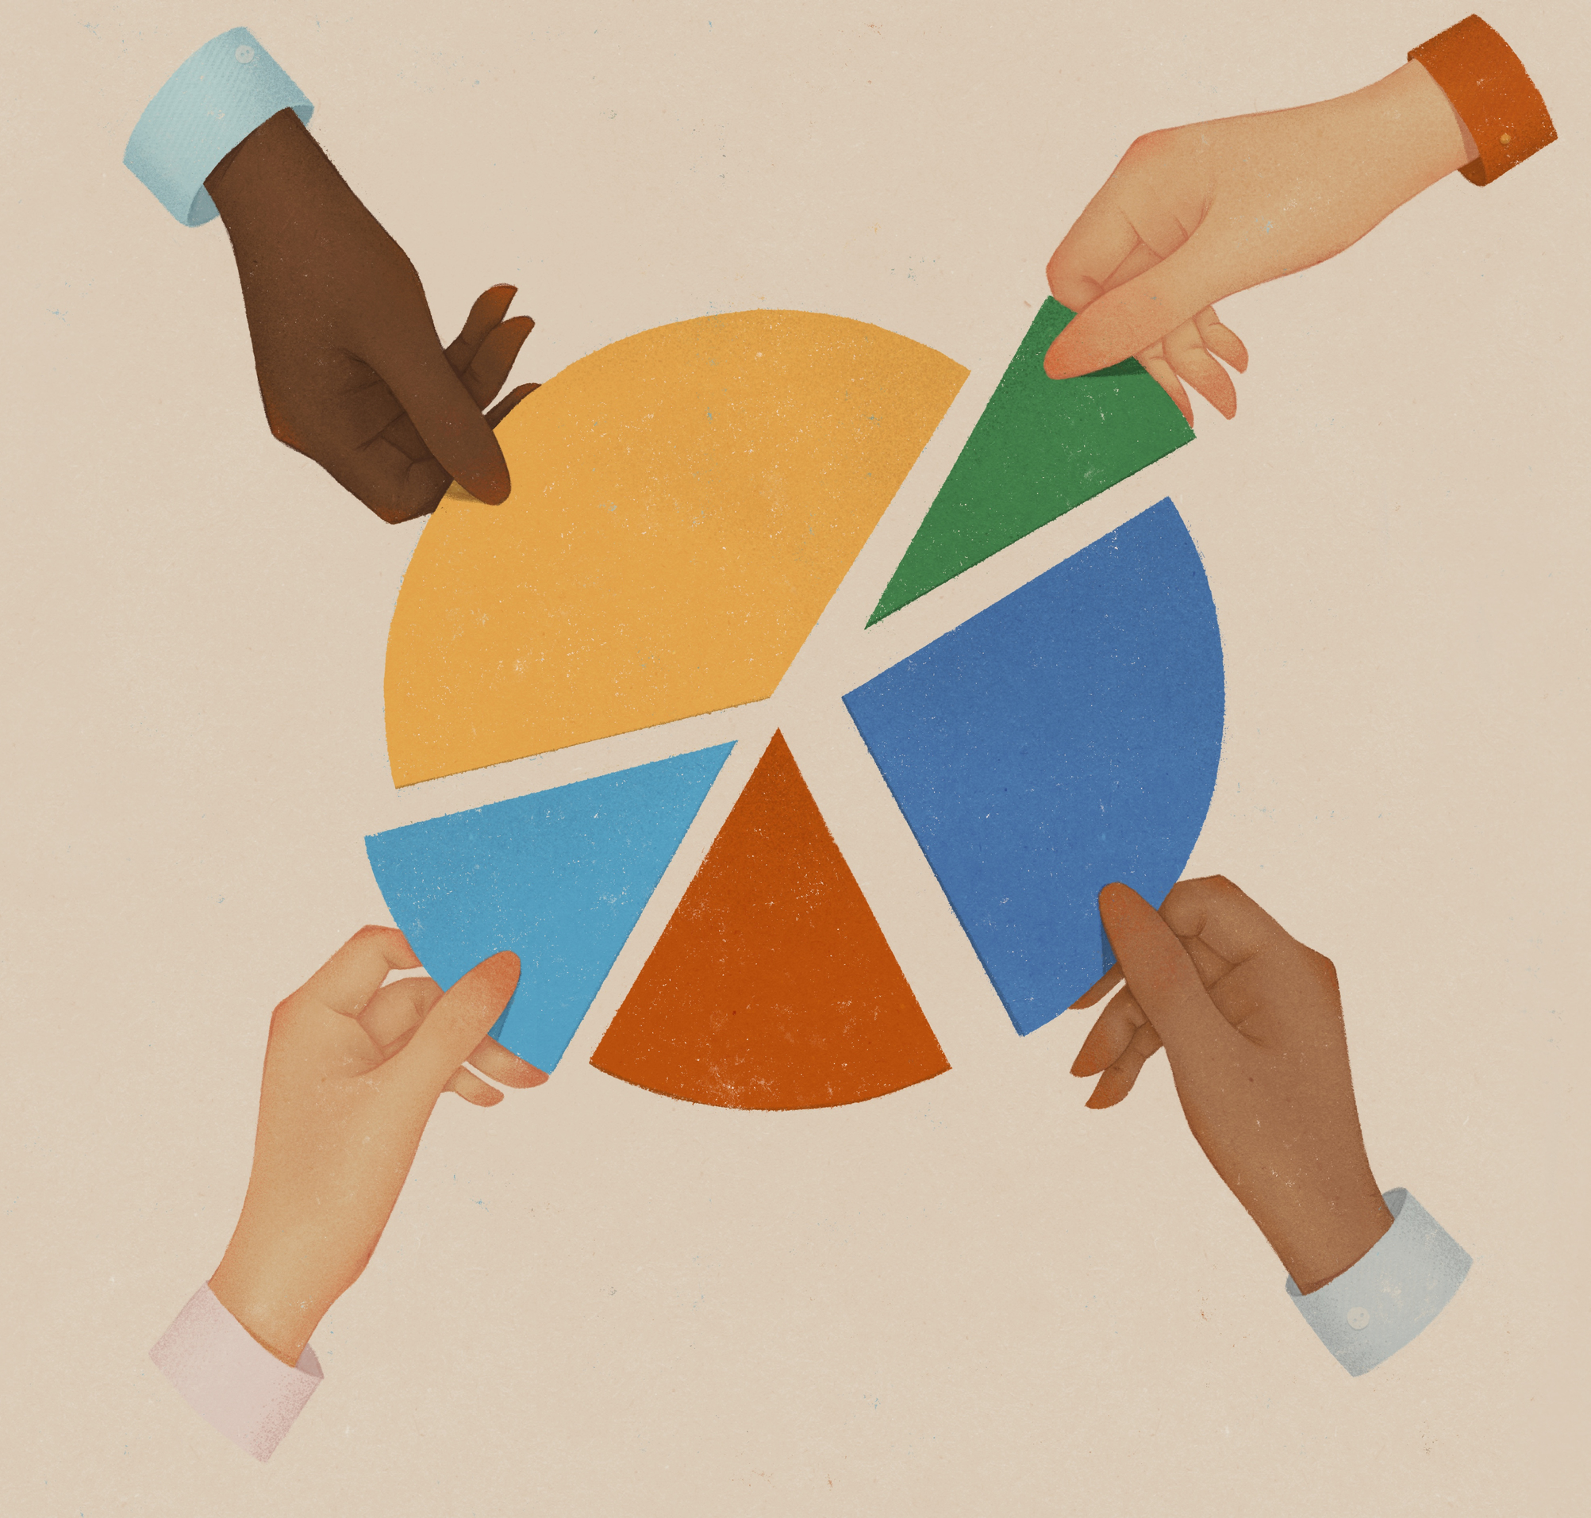
Us vs Them Trap
Framing groups as “others”
Zero-sum thinking
Examples:
“We can’t afford to accommodate everyone.”
“If we increase support for older adults or people with disabilities, others will lose out.”
Deciding who needs “more.”
Notes:
The zero-sum is based on scarcity and fear. There’s not enough for everyone. Therefore, if I make you “other” than deserving, worthy, etc. there will be enough for me.
In truth we live in an abundant society with enough for everyone.

Slide 33
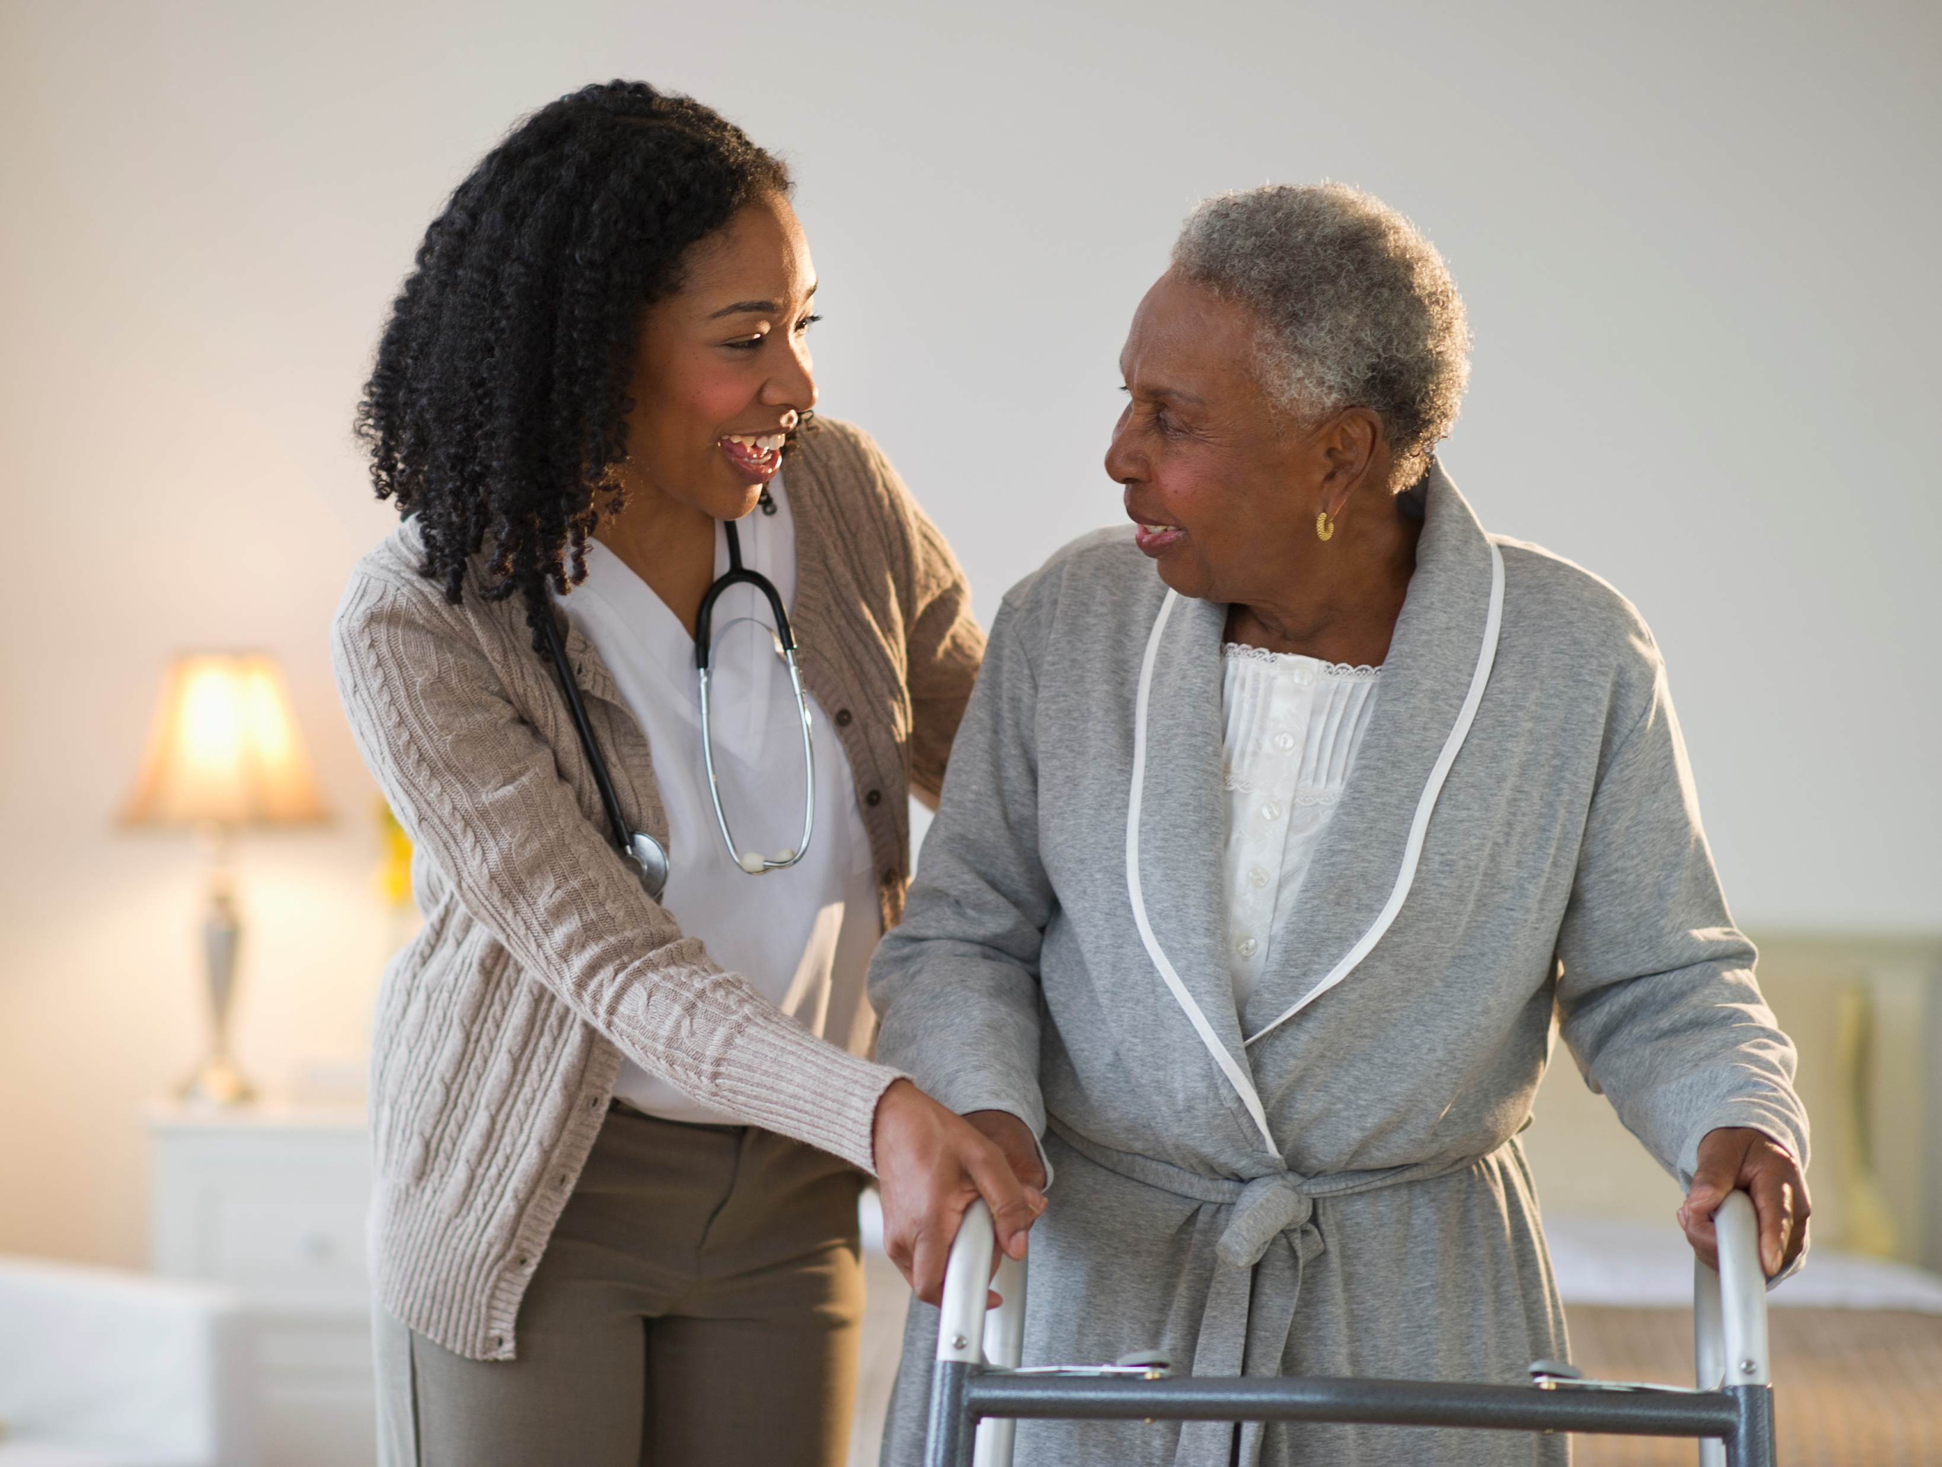
Vulnerability Trap
Paternalistic language
Victim-savior narrative
Assumptions of fragility, incompetence, or dependence
Examples:
“Older adults are frail and need help.”
Speaking to a caregiver or making decisions without asking the individual.
Assuming lower quality of life.
Notes:
Vulnerability is reinforcing the decay decline deteriorate frame. Whereas we all have times of decline – broke a leg as a kid? terrible flu as an adult?
Interestingly when doing a stock image search for “old” and “disabled” there were mostly positive images available. Things are changing!

Slide 34

Fatalism Trap
Starting with the problem
Amplify the dire nature of the problem
Overwhelms audience and reduce engagement
Examples:
The tidal wave of seniors is going to bankrupt the system.
Social Security is projected to run out of money in late 2032.
Meals on Wheels sets up waiting lists.
"It’s God’s will, so there is no point in fighting it."
“Older American’s Are Hoarding America’s Potential”
Notes:
When we “horribilize” or paint the bleakest picture possible it can work against us.

Slide 35
Strategies to Advance:
Talk about the process of aging as building momentum
The ideas we’re communicating:
As we age, we gain new insights and experiences that can power up our communities.
What it does:
Inspires a different story about aging
Reduces bias
Steers people away from othering old people
Notes:
It is not all downhill – like the rest of life, it’s a mixed bag.
GDP Impact: The $12.5 trillion generated by adults 50-plus in 2024 rivals the size of major national economies.
Active Workers: Nearly 57 million people aged 50 and older remain active in the U.S. labor force
Caregiving and Volunteering: Adults 50-plus provided the economic equivalent of $1.2 trillion in unpaid family caregiving and volunteer work in 2024. AARP Report: Older Americans Are Boosting the Economy

Slide 36
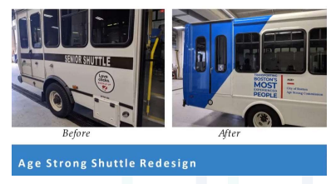
Building momentum
“Transporting Boston’s most experienced people.”
Information credit: National Center to Reframe Aging

Slide 37
Strategies to advance:
Prompt the can-do attitude
The ideas we’re communicating:
We are creative, inventive, problem-solving people. We have solved big problems before, and we can do it again!
What it does:
Steers people away from fatalistic thinking (that nothing can be done)
Encourages solutions-oriented thinking
Cues collective responsibility and benefit
Information credit: National Center to Reframe Aging
Notes:
The ideas we’re communicating:
We are creative, inventive, problem-solving people. We have solved big problems before, and we can do it again!

Slide 38
Strategies to advance:
Explain the supports we need to live meaningfully.
The ideas we’re communicating:
We all rely on a web of services and supports throughout our lives.
What it does:
Steers people away from othering old people and people with disabilities
Cultivates understand that what surrounds us, shapes us
Prompts appreciation for the idea that age and disability inclusive policy is good policy for everyone
Cues collective responsibility and benefit
Information credit: National Center to Reframe Aging

Slide 39
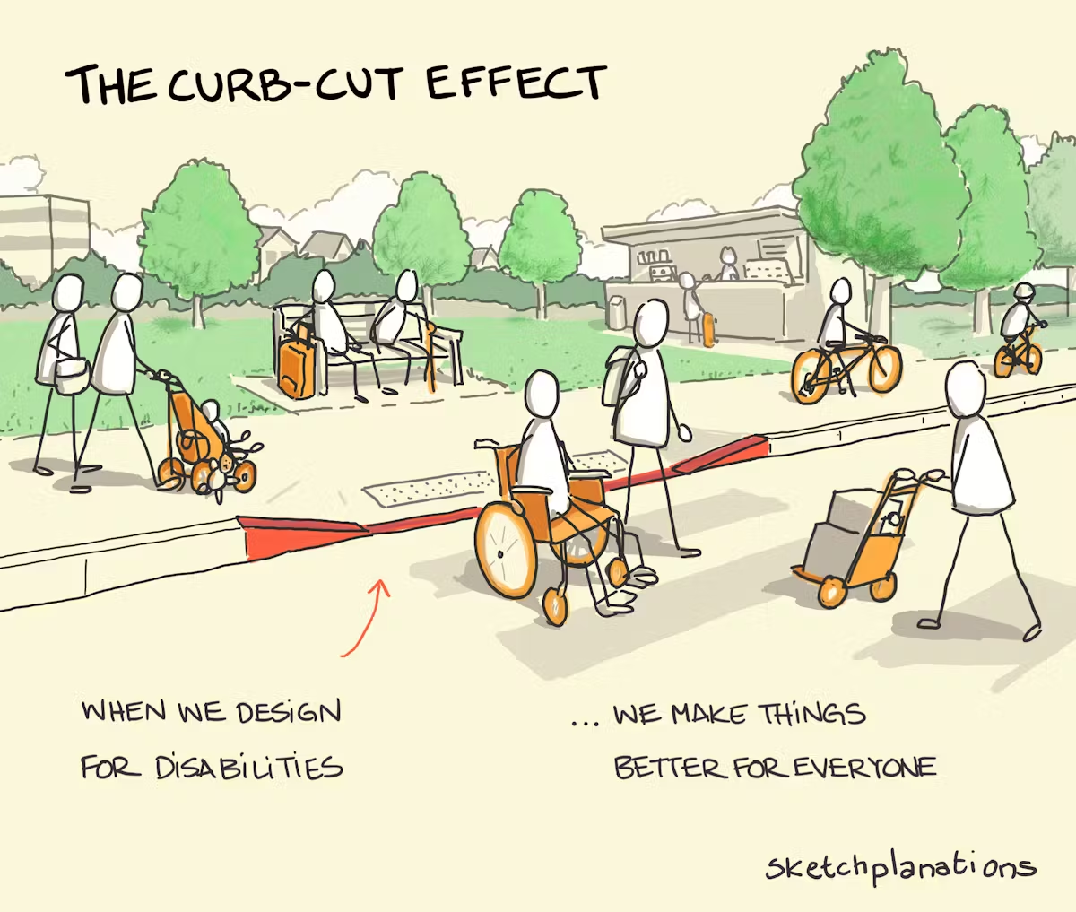
The Curb-Cut effect
Notes:
Describe how the curb cuts serve everyone.
For white cane users to scan for the change in elevation (drop-off) at a curb cut, textured surfaces, known as truncated domes were added. In 2001 (11 years after passage of the ADA) truncated domes became mandatory on all new or altered curb ramps. For the rest of us the texture adds more stability when walking in slippery winter conditions.

Slide 40
Strategies to advance:
Highlight disability as strength and contribution
The ideas we’re communicating:
Disability brings lived experience, creativity, empathy, and problem-solving.
People with disability contribute insights that strengthen communities.
What it does:
Challenges deficit-based narratives
Counters assumptions of incapacity
Inspires a fuller story of disability
Reduces bias by expanding how people define disability
Notes:
Disability pride as an example

Slide 41
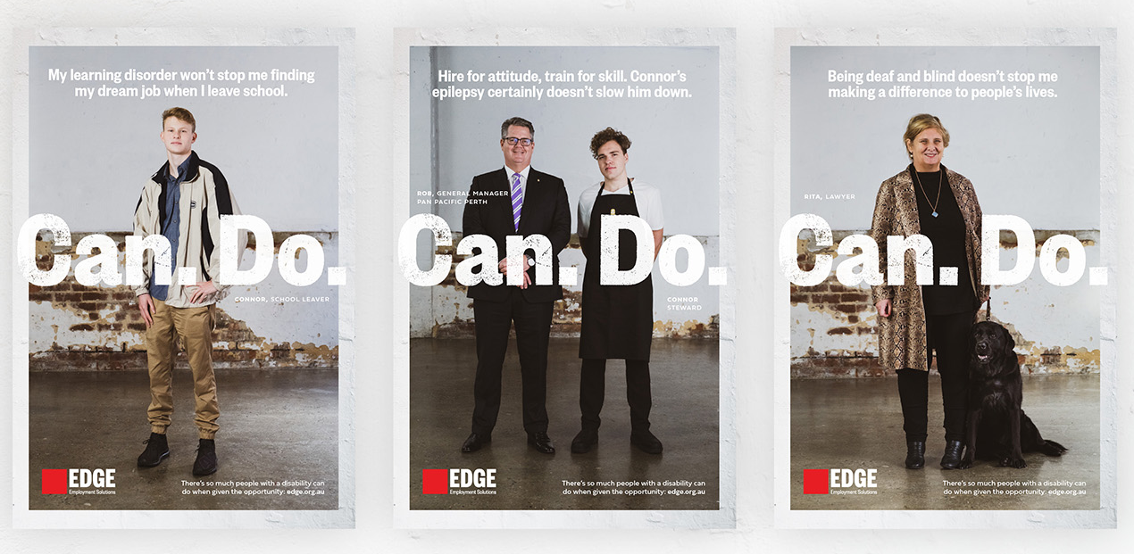
Disability as a Strength
Notes:
Image far left: "my learning disorder won't stop me finding my dream job when I leave school"
Image middle: "hire for attitude, train for skill. Connor's epilepsy certainly doesn't slow him down",
Image far right: "Being deaf and blind doesn't stop me making a difference to people's lives."
All three posters with the words "Can. Do.“
Important to focus on the strengths of individuals, not the deficits. People with disabilities bring insight, creativity, empathy, and unique skills (just like people without disabilities).
We have strengths and weaknesses.

Slide 42
Strategies to advance:
Recognize disability as a natural part of life
The ideas we’re communicating:
Disability is a normal part of the human experience
Most people will experience some level of disability, whether temporary, gradual, or lifelong
What it does:
Reduces “us vs. them” thinking
Encourages proactive policy and design
Reinforces shared responsibility and benefit
Moves the focus from fixing people to removing barriers
Notes:
Universal design: closed captions, curb cuts, etc.

Slide 43
Activity: ACL UPDATES 6-3-2026
Protecting Older Adults in Everyone’s Job
June is Elder Justice Awareness Month — and the numbers demand our attention. Older adults lost nearly $2.4 billion to fraud in 2024, up from $1.9 billion the year before.
Safety, dignity, and financial security for older adults aren't just individual concerns — they're shared responsibilities across our families and communities.
“Older adults with fewer regular check-ins have less trusted oversight.”
Victims often feel too embarrassed, afraid, or dependent on their exploiter to report what happened.
Strong communities are the frontline defense against elder abuse.
When older adults know what scams look like and feel confident recognizing warning signs, they're far better equipped to protect themselves.
Match the Traps
Individualism
Us vs. Them
Vulnerability
Fatalism
Match the Strategies
Building Momentum
Can-do Attitude
Collective Responsibility
Interdependence
Notes:
If you want to add an activity – find a document that is relevant for your group and select a few lines and match with the traps and strategies.

Slide 44
The message - unframed
What the message does:
Traps
  Us vs Them
  Fatalism
Lack of solutions thinking
  People think of solutions at an individual level (guardianship, family support, etc.)
No impact
  No policy or systems change
The area of elder abuse is growing with an older adult population that is set to increase by 72% by 2040. According to reports submitted by Adult Protectives Services agencies across Wisconsin, the increasing population of older adults is coupled with a rise in elder abuse cases, which have more than tripled from 2001-2023.
Notes:
What are the traps? What doesn’t work about this?

Slide 45
The message - reframed
What the message does:
Strategies to advance
  Focus on “Us”
  Context matters
  Solution focused
Effective solutions thinking
  People think of solutions at a systemic level – more likely to think of community programs
Broad impact
  Policy and systems change
“We all deserve to live with safety, dignity, and connection as we age.
Preventing abuse and fraud requires strong systems, trained professionals, and coordinated community response. As Wisconsin’s population ages, more people rely on these supports. Reports of elder abuse have more than tripled from 2001-2023, reflecting both growing awareness and the need to continue strengthening prevention and response.
Notes:
What’s better?

Slide 46
Wisconsin example: Yes, We Can!
PRE-Reframing:
The Bureau of Aging and Disability Resources (BADR) is responsible for the development of policy and the management of programs that serve persons who are elderly, persons with physical disabilities, persons who are blind or visually impaired, persons who are deaf, hard-of-hearing or Deaf-Blind, persons in need of adult protective services and persons who need or receive information about or access to community-based long-term support through an Aging and Disability Resource Center. BADR carries out its responsibilities under contracts with multiple federal agencies in a way that actively promotes individual choice, dignity, relationships, overall health, community participation, self-sufficiency and respect. BADR works closely with other units of the Department of Health Services to implement the long-term care reform proposals that utilize the aging and disability resource centers (ADRCs) as single points of entry.
POST-Reframing:
The Bureau of Aging and Disability Resources (BADR) moves our state forward in upholding our right to participate fully in our community as we age or experience disability. We partner with an extensive network of experts and advocates to build policies, structures, and systems that support our needs as they evolve over the course of our lives. Together, we chart a healthier path forward for everyone.
The Bureau works closely with all our partners and other units in the Department of Health Services to develop policies that are responsive to our needs as we age and/or experience disability and effectively promote continued participation and contribution in the community.
Source: https://www.dhs.wisconsin.gov/dph/badr.htm
Notes:
I usually read the first few lines of the pre out loud and fast with a “you get the idea” followed by focusing on the red highlighted content on the right.

Slide 47
Wisconsin example: Us vs. Them
PRE: Why a Waitlist for Home-Delivered Meals Is Being Implemented
Every day, older adults in our community depend on Home-Delivered Meals (HDMs) for nourishment, daily safety checks, and the reassurance that someone cares. These meals are often a lifeline that helps older adults remain healthy and independent in their own homes. Unfortunately, the need for meals has grown faster than available funding. Despite federal support through the Older Americans Act, combined with state, local, and participant contributions, the resources simply don’t stretch far enough to serve everyone who qualifies.
POST: Fully Funding Home-Delivered Meals Matters
We all want to age with dignity and a sense of agency. Food is a basic human need and a social connector. Local agencies have been delivering meals for over 50 years. These meals are one of the most effective, community-based prevention strategies available to help Wisconsinites, age 60 and older age in place. Every day, home-delivered meals (HDMs) provide aging parents, grandparents, veterans, neighbors, and caregivers nourishment, social interaction, and essential safety checks. These meals are a lifeline to remaining healthy and independent in our own homes as we age.
Notes:
SIMPLE change – we all! Leading with the solution we already have.

Slide 48
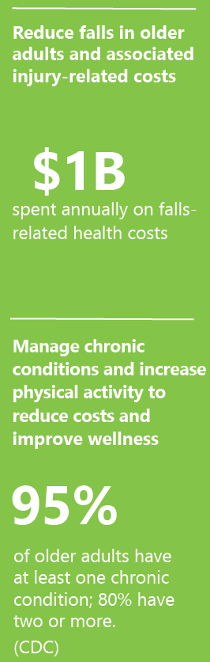
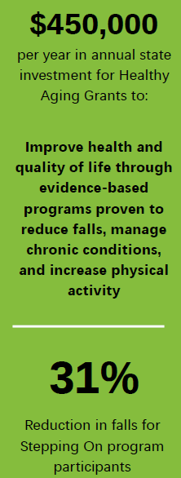
Wisconsin example: Reframe Fatalism
PRE:
Healthy Aging Grants
Reducing falls. Managing chronic conditions. Reducing costs.
Today, one in four Wisconsinites is 60 or older; by 2040, it will be one in three. The demand for services, health care, and long-term care is growing. But what if we could reduce that demand by improving the health and well-being of people as they age?
POST:
Healthy Aging Grants
Reducing falls. Managing chronic conditions. Reducing costs.
Aging is a lifelong process that connects us all. Today, one in four Wisconsinites is age 60 or older – and by 22040, it will be one in three. Now is the time to invest in systems that promote health, connection, and independence throughout our lives – strengthening the foundation for well-being in every community.
Problem and Cost
Solution and Impact
Notes:
WIHA slide
Healthy Aging grants issue brief. Given to legislators. An example of minor changes that can make a big impact.
Changes:
In the introduction, we start with a statement that connects all of us to aging (Us vs. Them), then goes into the statistic about the number of Wisconsinites over 60. Then states strategies to advance including the simple solution and call to action stated to close out the paragraph.
On the side bar, bolded the benefits of what the investment would accomplish. Then, instead of the alarming negative statistics highlighted (billions of dollars spent on falls and the high percentage of chronic conditions), we substituted the positive impact statistics (how our programs reduce falls by 31% and then the millions of dollars the programs save the state in healthcare costs). This draws attention to the opportunity instead of the problem.

Slide 49
Small steps = big change
Getting started:
Focus on the “Us vs them” and use “we” and “our”
Small edits to fact sheets, social media, newsletters, websites
Flip the script. Instead of introducing fatalism/scary stats, begin with opportunity.
Be thoughtful about the images we use
We are ALL aging!
It is likely we will all experience disability at some point in life, whether that is aging with or into a disability
Notes:
Images – it’s ok to show someone in a wheelchair but show them engaging with others and participating in their community.

Slide 50
When
Now!

Slide 51
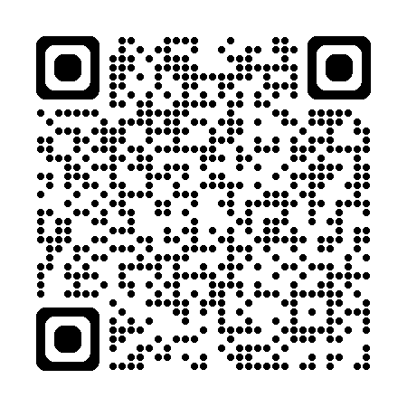
Join the Movement
Visit us at: Reframing Aging & Disability | WIHA
Sign Up for the
Champions’ Newsletter:
Notes:
We invite you to join us on the journey to reframe aging and disability by engaging in learning and mindset shift and by adopting and integrating the resources and tools available through NCRA. Help us plan, disseminate and celebrate a new story for all Wisconsites!

Slide 52
What’s next?
Continue our Advisory Committee who have become ambassadors and offer guidance
Continue to make the Community of Practice more accessible to everyone
Continue making our information hub valuable: Reframing Aging & Disability | WIHA
Ongoing local and national training
Develop data mechanisms for evaluation
Continue to spread!
Practice until we feel confident and reframing is second nature!
Notes:
1. To identify resources, prioritize activities and focus (e.g. professionals, media, general public)
2. To develop reframed resources, identify needs, etc.
3. Research based
4. Tied to the “long path” charge for the Long-Term Care Advisory Committee
Social movements typically take decades or even centuries to achieve major, lasting, and transformative results. While rapid, smaller-scale policy changes can occur within a few years, fundamental shifts in societal norms, laws, or culture are slow, often requiring sustained efforts over many years.

Slide 53
Let’s Play – using the principles of reframing…
Create an elevator speech describing reframing
or
Respond to the comment “you look good for your age.”
or
Respond to the comment, “you don’t look disabled…”
We’ll assign you to a break out room and you can choose 1 of the two prompts to work on.
Introduce yourselves and see what you can create in 10 minutes.
Select a reporter and be prepared to share briefly with the whole group.
Notes:
If you want to add an activity – unhide this slide.

Slide 54
Thank you!
Helen Sampson, LCSW (she/her)
Public Policy Strategist
Bureau of Aging and Disability Resources | Division of Public Health
Wisconsin Department of Health Services
Phone: 262-317-4941| Email: helen.sampson@dhs.wisconsin.gov

Slide 55
References
Bogart, K. R. (2014). The role of disability self-concept in adaptation to chronic illness. Rehabilitation Psychology, 59(3), 271–281. https://doi.org/10.1037/a0036870
Busso, D. S., Volmert, A., & Kendall-Taylor, N. (2019). Reframing aging: Effect of a short-term framing intervention on implicit measures of age bias. The Journals of Gerontology: Series B, 74(4), 559–564. https://doi.org/10.1093/geronb/gby119
Iezzoni, L. I. (2011). Eliminating health and health care disparities among the growing population of people with disabilities. Health Affairs, 30(10), 1947–1954. https://doi.org/10.1377/hlthaff.2011.0613
Levy, B. R., Slade, M. D., Kunkel, S. R., & Stanislav, V. (2002). Longevity increased by positive self-perceptions of aging. Journal of Personality and Social Psychology, 83(2), 261–270. https://doi.org/10.1037/0022-3514.83.2.261

