Slide 1

Session 5 (Refresher)
Program Creator: Kelli F Koltyn

Slide 2
Ground Rules
Notes:
There are two text boxes here that both work in presentation mode. Facilitator should type on the slide. Press shift+Enter to move to the next line.

Slide 3

Addressing Barriers - pg 24
What is the barrier?
Why does the barrier prevent me from reaching my goal?
How might I remove the barrier and help it to become less of a problem?
Does my goal need to change in order for me to be more successful?

Slide 4
Motivators
Facilitator to copy brainstorm from session 4 ppt to here
“How might stand up and moving more improve my life”.
Notes:
This text box works in presentation mode. Facilitator should type on the slide. Press shift+Enter to move to the next line.

Slide 5
How might standing more improve my life?
Notes:
There are two text boxes here that both work in presentation mode. Facilitator should type on the slide. Press shift+Enter to move to the next line.

Slide 6
Benefits
Facilitator to copy brainstorm from session XX ppt to here
“Benefits”.
Notes:
This text box works in presentation mode. Facilitator should type on the slide. Press shift+Enter to move to the next line.

Slide 7
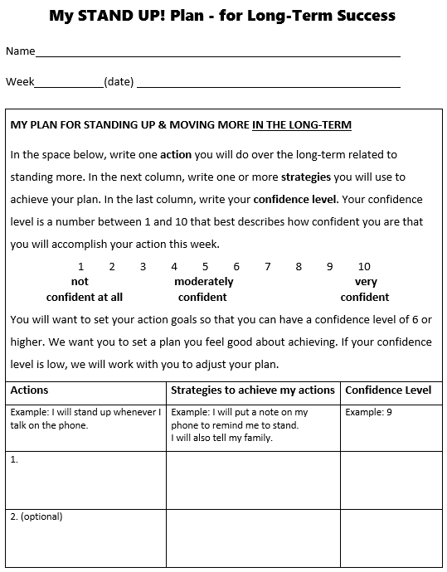
Participant Guide pg 54

Slide 8
Barriers – pg 44
IF…
THEN…
Notes:
If needed.
These text boxes work in presentation mode. Facilitator should type on the slide.

Slide 9
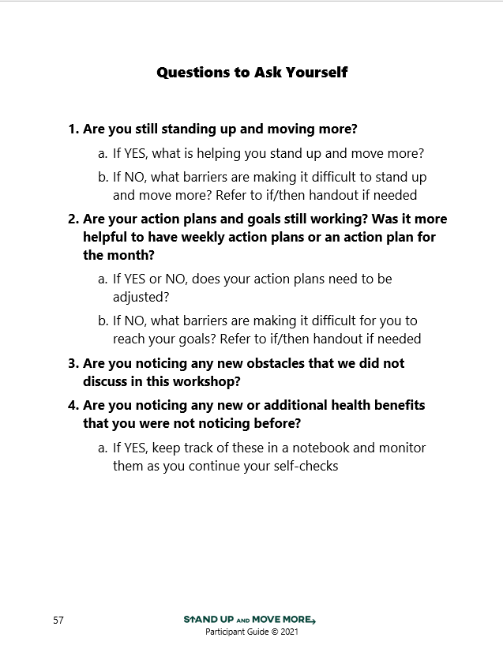
Participant Guide pg 56

Slide 10
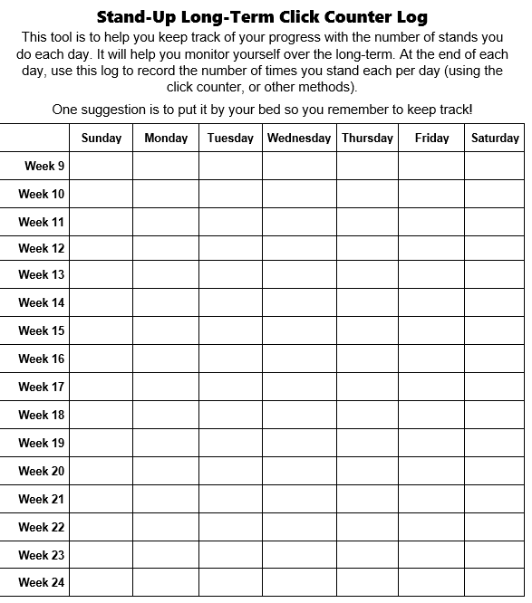
Participant Guide pg 58

Slide 11
Self-Check Strategies
Facilitator to copy brainstorm from session XX ppt to here
“Benefits”.
Notes:
This text box works in presentation mode. Facilitator should type on the slide. Press shift+Enter to move to the next line.

Slide 12
Close
Questions?

