Slide 1

Session 4
Program Creator: Kelli F Koltyn

Slide 2
Ground Rules
Notes:
There are two text boxes here that both work in presentation mode. Facilitator should type on the slide. Press shift+Enter to move to the next line.

Slide 3
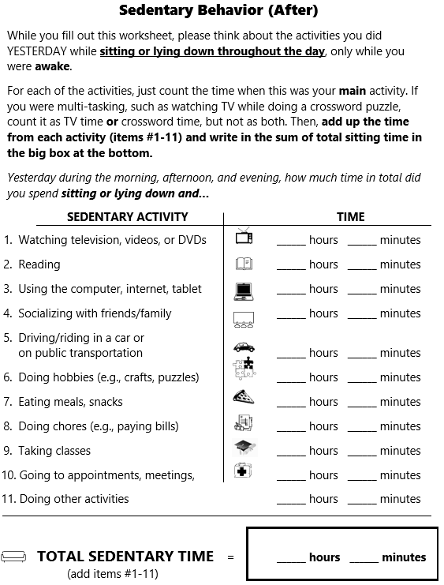

Participant Guide pg 40

Slide 4
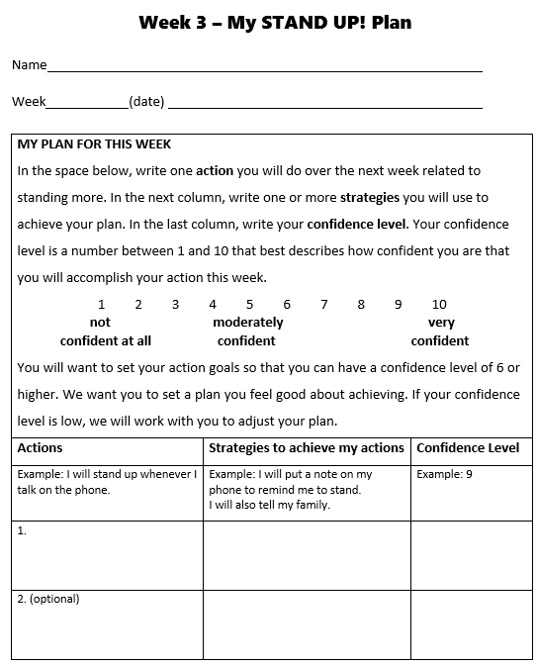
Participant Guide pg 34

Slide 5
Addressing Barriers - pg 24
What is the barrier?
Why does the barrier prevent me from reaching my goal?
How might I remove the barrier and help it to become less of a problem?
Does my goal need to change in order for me to be more successful?

Slide 6
How might standing more improve my life?
Notes:
This text box works in presentation mode. Facilitator should type on the slide. Press shift+Enter to move to the next line.

Slide 7
How can we stay motivated to reach our goal for sitting less after this class?
Facilitator to copy brainstorm from session 3 ppt to here.
Notes:
This text box works in presentation mode. Facilitator should type on the slide. Press shift+Enter to move to the next line.

Slide 8
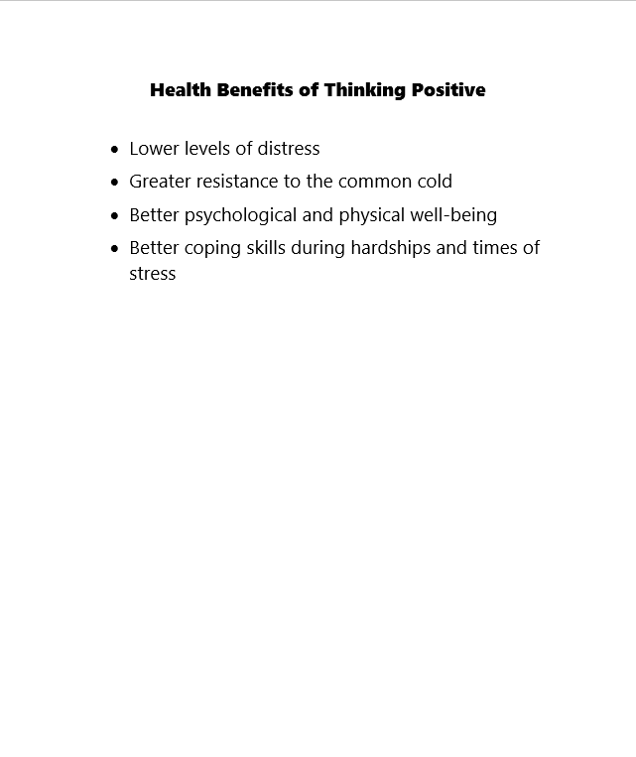
Participant Guide pg 42

Slide 9
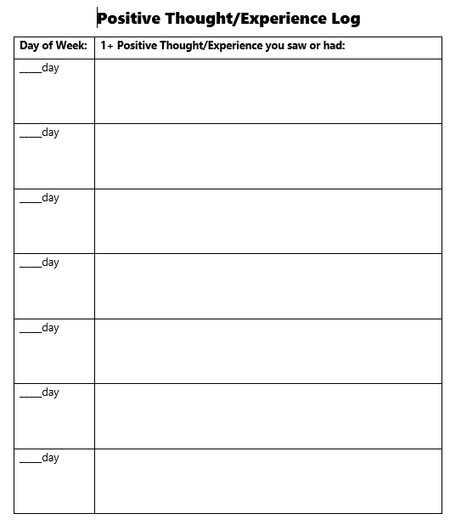
Participant Guide pg 43

Slide 10
Ways to stay active in the community
Notes:
This text box works in presentation mode. Facilitator should type on the slide. Press shift+Enter to move to the next line.

Slide 11
Barriers – pg 44
IF…
THEN…
Notes:
These text boxes work in presentation mode. Facilitator should type on the slide.

Slide 12
Addressing Barriers - pg 24
What is the barrier?
Why does the barrier prevent me from reaching my goal?
How might I remove the barrier and help it to become less of a problem?
Does my goal need to change in order for me to be more successful?

Slide 13
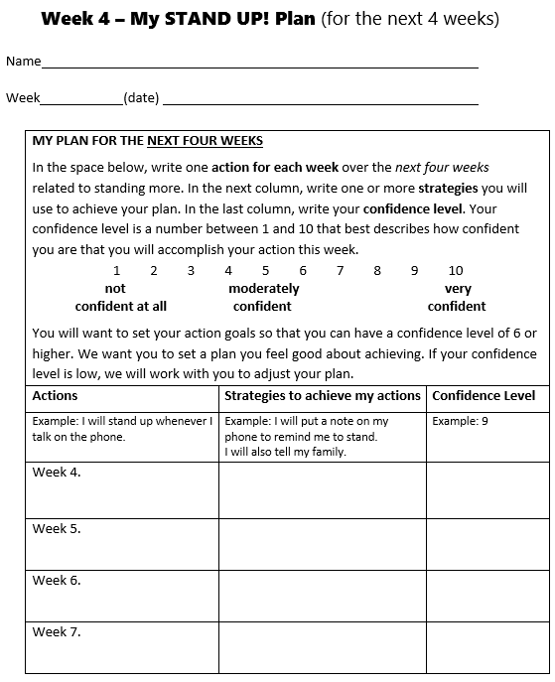
Participant Guide pg 46

Slide 14
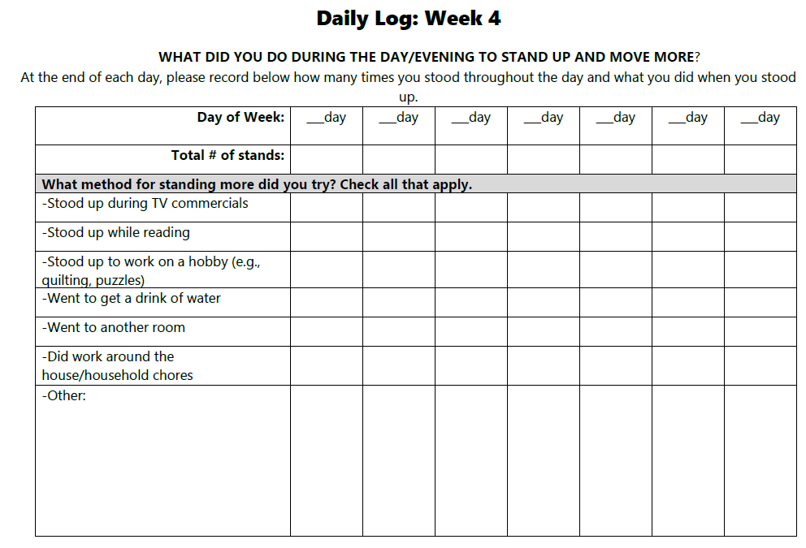
Participant Guide pg 48-51

Slide 15
Close
Refresher session in 4 weeks
Questions?

