Slide 1

Session 3
Program Creator: Kelli F Koltyn

Slide 2
Ground Rules
Notes:
There are two text boxes here that both work in presentation mode. Facilitator should type on the slide. Press shift+Enter to move to the next line.

Slide 3
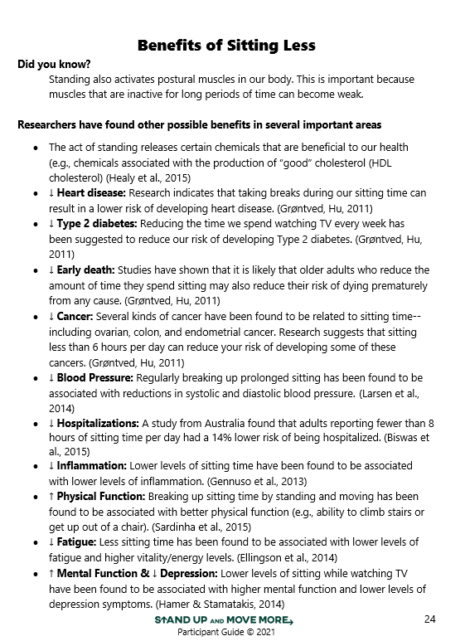

Participant Guide pg 22

Slide 4
How might standing more improve my life?
Notes:
Copy and paste this completed slide from Session 2.

Slide 5
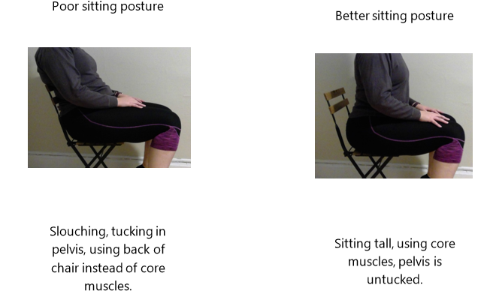
Participant Guide - pg 32

Slide 6
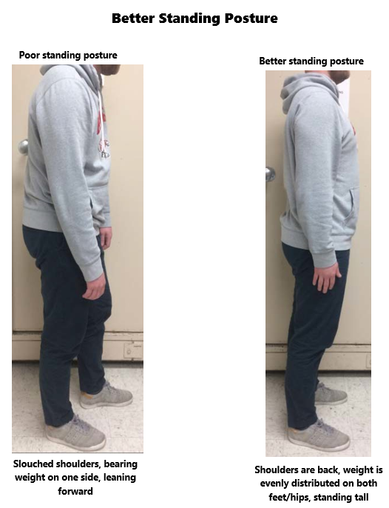
Participant Guide pg 33

Slide 7
Addressing Barriers - pg 24
What is the barrier?
Why does the barrier prevent me from reaching my goal?
How might I remove the barrier and help it to become less of a problem?
Does my goal need to change in order for me to be more successful?

Slide 8
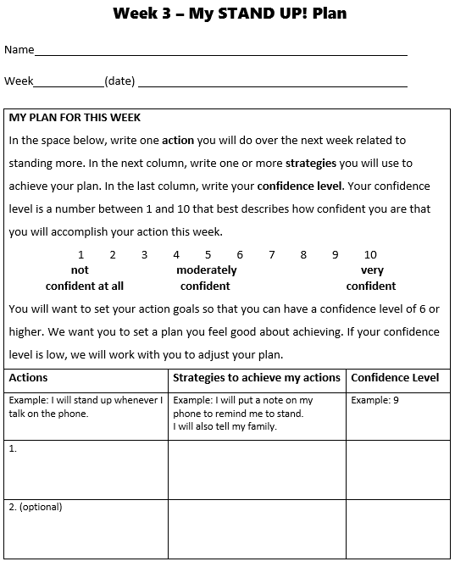
Participant Guide pg 34

Slide 9
How can we stay motivated to reach our goal for sitting less after this class?
Notes:
This text box works in presentation mode. Facilitator should type on the slide. Press shift+Enter to move to the next line.

Slide 10
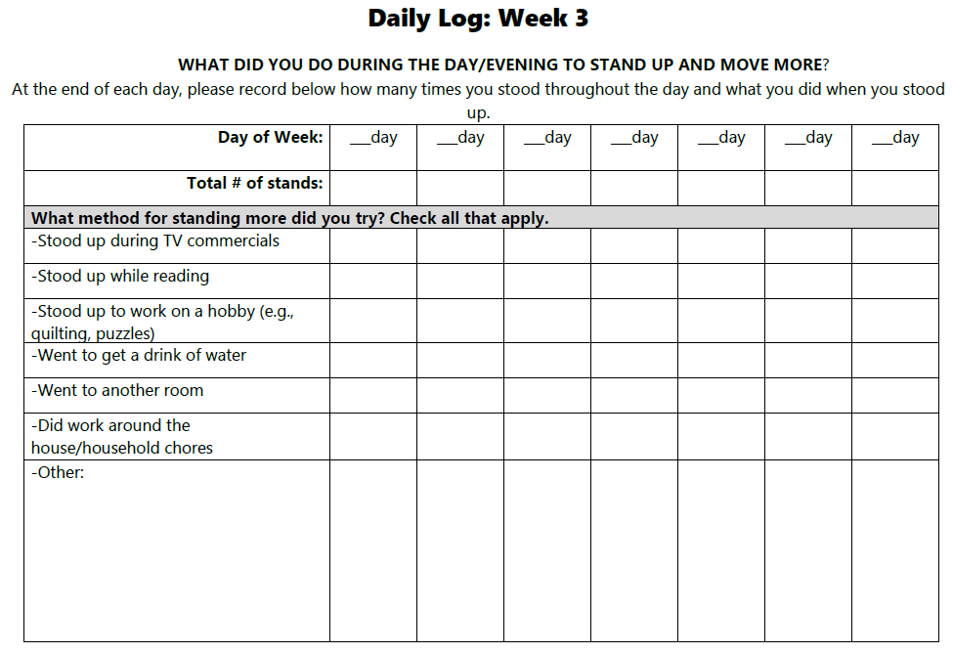
Participant Guide pg 36

Slide 11
Close
Questions?
Next session

