Slide 1

Session 2
Program Creator: Kelli F Koltyn

Slide 2
Ground Rules
Notes:
There are two text boxes here that both work in presentation mode. Facilitator should type on the slide. Press shift+Enter to move to the next line.

Slide 3
How might standing more improve my life?
Notes:
There are two text boxes here that both work in presentation mode. Facilitator should type on the slide. Press shift+Enter to move to the next line.

Slide 4
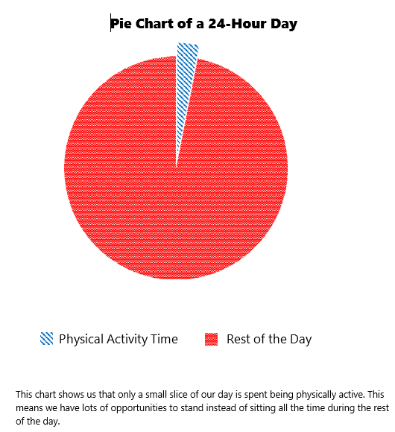

Participant Guide pg 12

Slide 5
Benefits of Sitting Less - pg 22
↓ Heart disease
↓ Type 2 diabetes
↓ Early death
↓ Cancer
↓ Blood pressure
↓ Hospitalizations
↓ Inflammation
↑ Physical function
↓ Fatigue
↑ Mental function & ↓ Depression

Slide 6
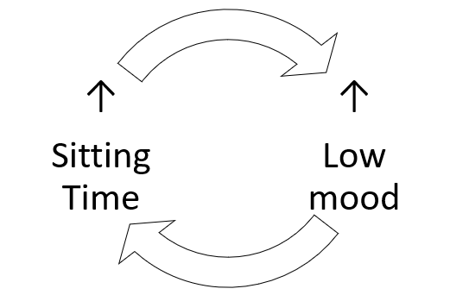
Mood & Sitting Time - pg 23

Slide 7
Ways to improve mood with less sitting
Notes:
There are two text boxes here that both work in presentation mode. Facilitator should type on the slide. Press shift+Enter to move to the next line.

Slide 8
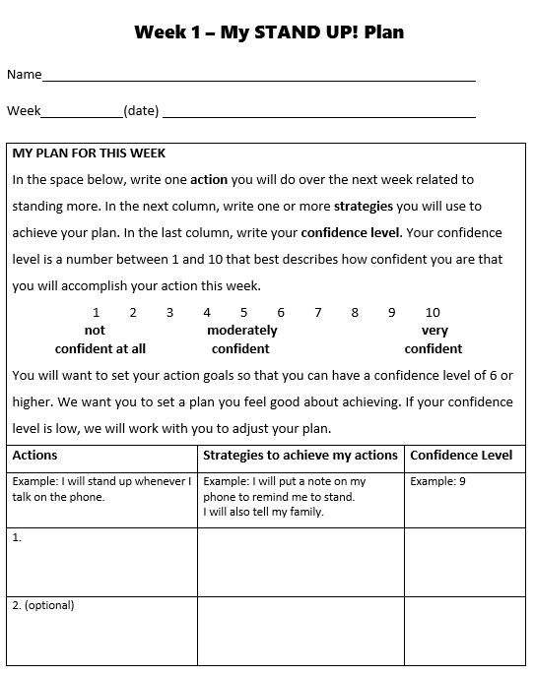
Participant Guide pg 16

Slide 9
Addressing Barriers - pg 24
What is the barrier?
Why does the barrier prevent me from reaching my goal?
How might I remove the barrier and help it to become less of a problem?
Does my goal need to change in order for me to be more successful?

Slide 10
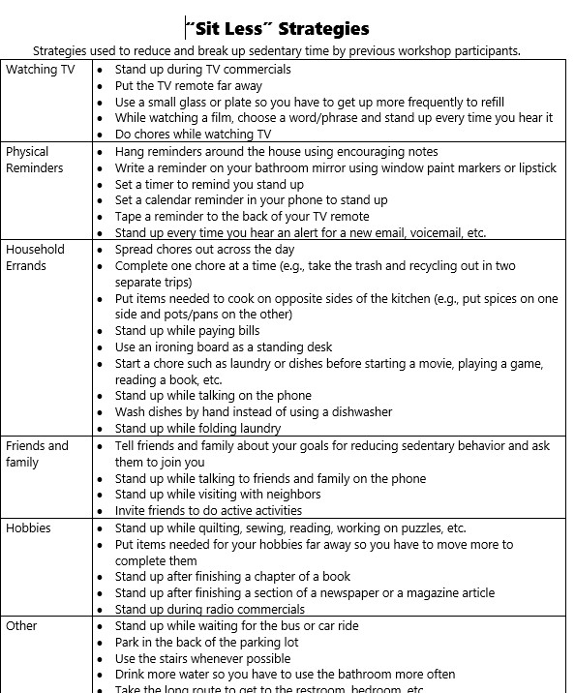
Participant Guide pg 25

Slide 11
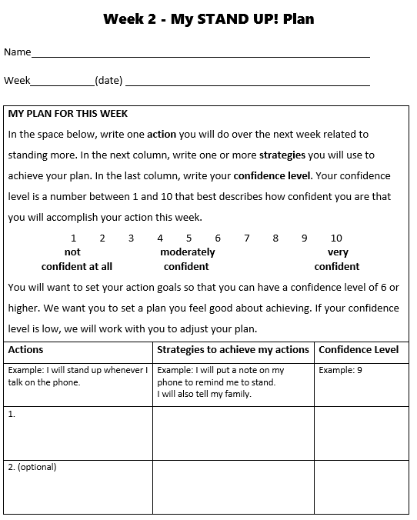
Participant Guide pg 26

Slide 12
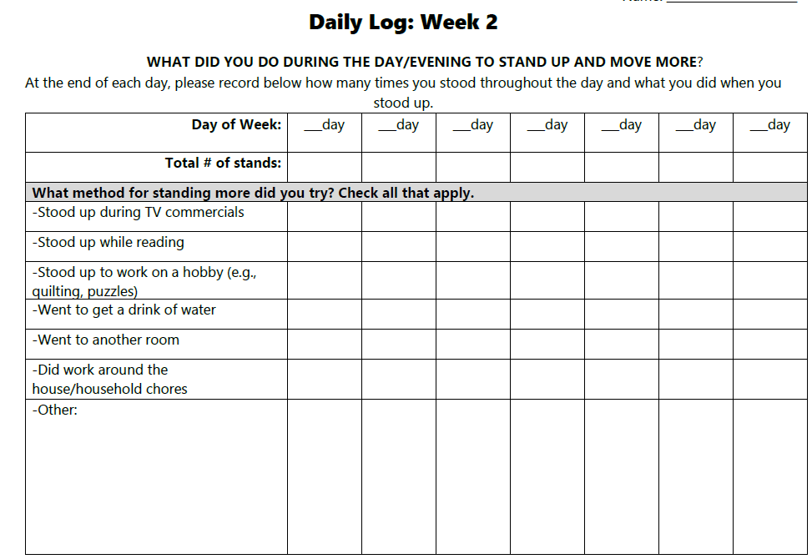
Participant Guide pg 28

Slide 13
Close
Questions?
Next class

