Slide 1

Session 1
Program Creator: Kelli F Koltyn

Slide 2
Ground Rules
Notes:
There are two text boxes here that both work in presentation mode. Facilitator should type on the slide. Press shift+Enter to move to the next line.

Slide 3
What is sedentary behavior?
Notes:
This text box works in presentation mode. Facilitator should type on the slide. Press shift+Enter to move to the next line.

Slide 4
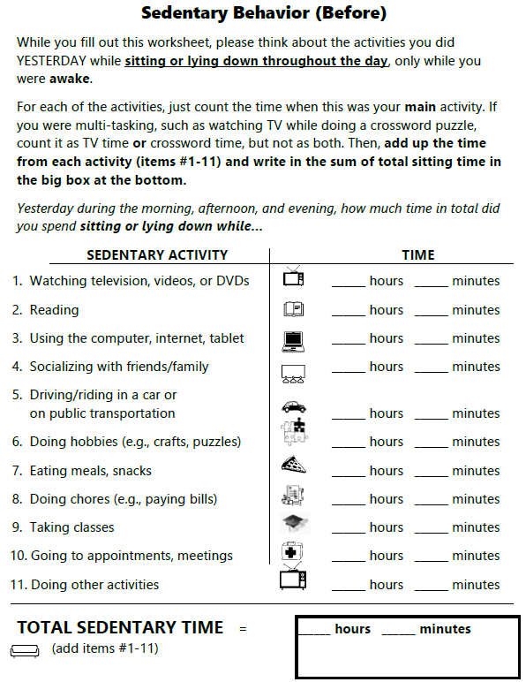

Participant Guide pg 8

Slide 5
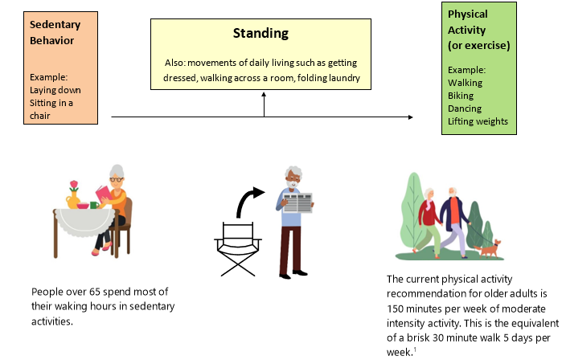
Participant Guide - pg 10

Slide 6
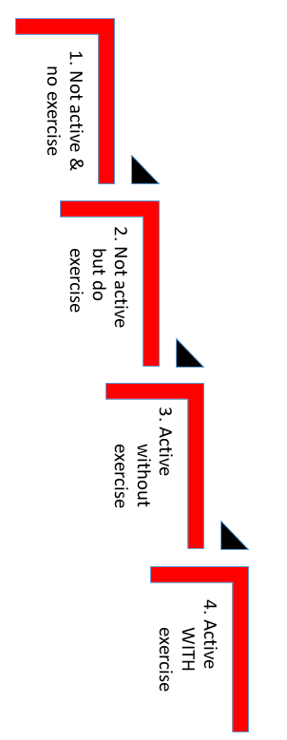
Participant Guide - pg 11

Slide 7
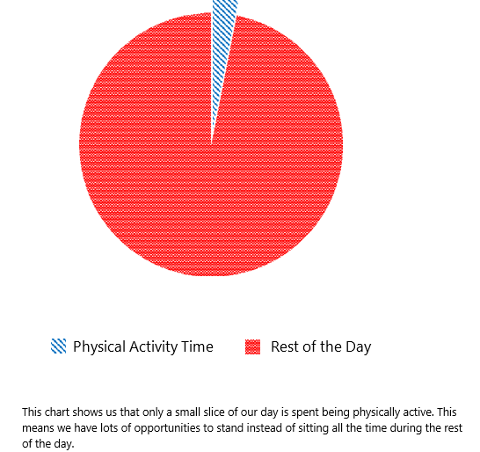
Participant Guide pg 12

Slide 8
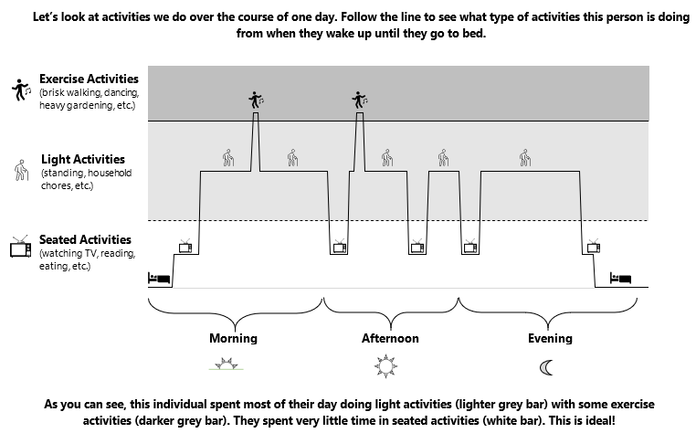
Participant Guide - pg 13 (Ideal)

Slide 9
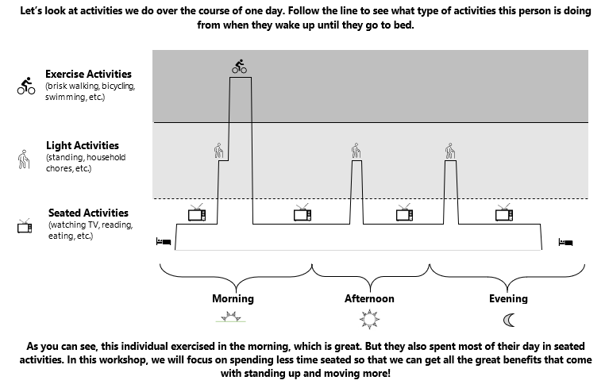
Participant Guide - pg 14 (Not Ideal)

Slide 10
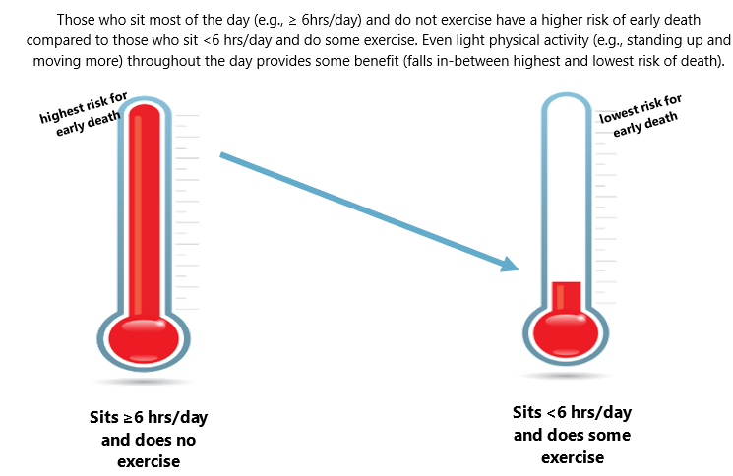
Participant Guide - pg 15 (Risk of Death)

Slide 11
Brainstorming Rules
Anyone can share
The purpose of brainstorming is to get as many ideas as possible written down (no right or wrong!)
Hold side comments and questions until after the brainstorming is done.

Slide 12
How do you spend your sitting time?
Notes:
This text box works in presentation mode. Facilitator should type on the slide. Press shift+Enter to move to the next line.

Slide 13
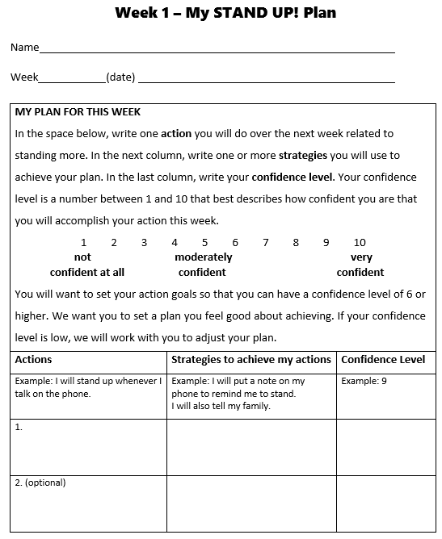
Participant Guide pg 16

Slide 14
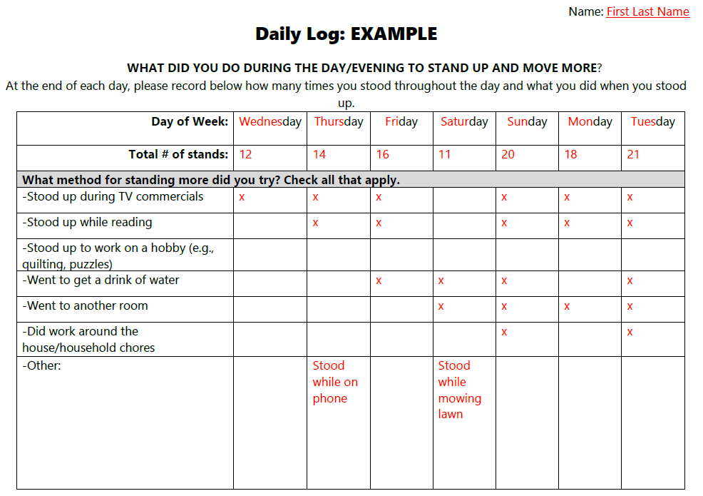
Participant Guide: Page 18 & 19

Slide 15
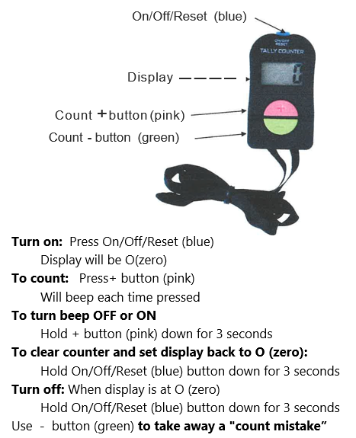
Digital Click Counter Handout

Slide 16
Close
Questions?
Next class

