Slide 1
How to Zoom
Session 0: Technology Check

Slide 2
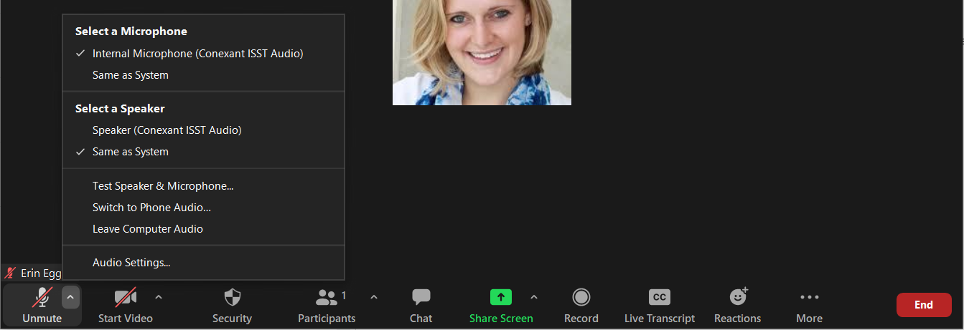
Welcome!
We will begin shortly.
For help, please call (555) 555-5555.
Please test your audio

Slide 3
General Zoom Functions
1
Notes:
1- Describe how to mute and unmute and what the button looks like.
Have everyone practice

Slide 4
General Zoom Functions
2
Notes:
2- describe how to start video recording. And what the video looks like then.
Have everyone practice turning off and then back on.

Slide 5
General Zoom Functions
Sally Jo Smith
3
Marcus Johnson
Hao Lee
Notes:
Describe what the participants button does.

Slide 6
General Zoom Functions
4
Notes:
Describe what the chat box does.
Have everyone practice by using an ice breaker question and having them enter into the chat. Something like “What is your favorite smell?”

Slide 7
General Zoom Functions
5
Notes:
Describe what share screen is and that participants may not use that feature.

Slide 8
General Zoom Functions
6
Notes:
Describe the record button and that leaders will NOT be recording and participants will not have the ability to start a recording either.

Slide 9
General Zoom Functions
7
Notes:
Describe the live transcripts feature.

Slide 10
General Zoom Functions
8
Notes:
Describe reactions button
Clapping
Thumbs up
Love
Hilarious
Wow
Celebrate
Have everyone practice by giving a reaction.

Slide 11
General Zoom Functions
9
Notes:
Describe end

Slide 12
General Zoom Functions
11
10
Notes:
Describe Gallery and Speaker View
Describe Full Screen

Slide 13
About your program

Slide 14
Materials
Participant Guide
Walk through
Pen/Pencil

Slide 15
Upcoming Sessions
Tuesdays, 9-11am
Same zoom link for all sessions

