Slide 1
Help Yourself
to Better Health
Simple steps you can take to have more control of your health

Slide 2
Did you know?
People who have POSITIVE associations with growing older live an average of 7.5 year LONGER than those who feel that aging is an inevitable decline in health and abilities.
Notes:
What do we mean by POSITIVE ATTITUDES? That means people who see aging as a good thing – see opportunities and good experiences . NEGATIVE ATTITUDES are feeling that growing older means inevitable illness, decline, loss of abilities.

Slide 3
Raise your hand if you . . .
Wear a seat belt
Get a flu shot
Take vitamin supplements or calcium
Wear sunscreen or a hat if out in the sun
Watch your salt and sugar intake
Leave the light on if you got out at night so your home is well-lit when you return
Limit your alcohol – especially if taking
medications
Notes:
Great to see so many hands! Do you know why you do these things? Because like us, YOU believe in Prevention. YOU believe in healthy aging. YOU believe in science. Because researchers and scientists have identified all of these “interventions” as things that will help you stay well longer.

Slide 4
Four Sets of Factors Impact Your Health
Care Received in a Hospital or Clinic
Your Own Health Behaviors
Social & Economic Factors
Physical Environment
Notes:
Did you know that there are four major sets of factors that impact your health?
Clinical Care: That’s your ACCESS TO CARE and the QUALITY OF CARE from docs, hospitals.
Physical Environment: That’s Air & Water Quality, Housing and Transit
Your Health Behaviors: That’s your use of tobacco, diet and exercise, alcohol and drug use, and sexual activity
Social & Economic Factors: That’s education, employment, income, family and social support and Community Safety

Slide 5
What impacts your health most? Care in a Hospital or Clinic impacts what % of your overall health?
80 %
60 %
40 %
20 %
Notes:
How many of you think it’s 80%? 60%? 40%? 20 %? And the answer is……………… ONLY 20%

Slide 6
What impacts your health most? Your own health behavior impacts what % of your overall health?
10 %
15 %
20 %
30 %
Notes:
How many of you think it’s 10%? 15% 20% 30% And the answer is……………… 30% That’s right – what YOU DO at home about your health has a bigger impact than what the doctors and hospitals prescribe and do “to” you.

Slide 7
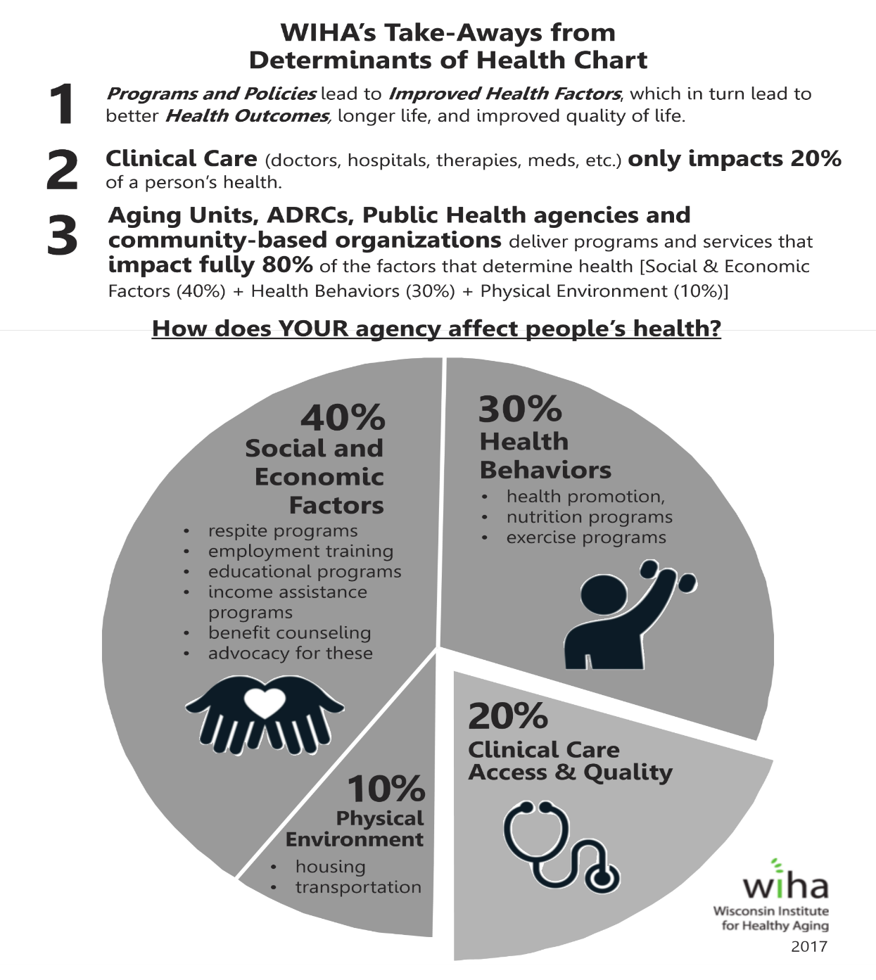
Notes:
Now let’s look at all the factors. Notice that CLINICAL care is only 20%. Your own health behavior is a larger slice of the pie at 30%
Physical environment contributes 10% and the biggest section of all, at 40% is Social and Economic Factors.
How often do you see your health care provider? Now, how often do you see yourself? Every day, right?! You have a daily opportunity to do something to improve your health.

Slide 8
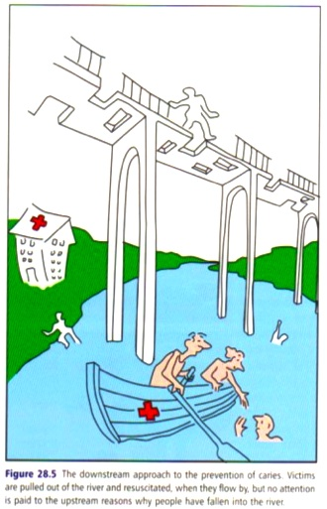
Health Promotion Role in Delaying or Preventing the Need for LTC
Notes:
Yes, the more we take care of OURSELVES, the better chance we’ll continue on our journey into aging with solid footing, and NOT fall into the long-term care waters…..

Slide 9
What is WIHA? And why should you care?
Non-profit clearinghouse of researched and proven (evidence-based) health promotion programs
Our mission is to bring evidence-based programs to communities throughout Wisconsin to encourage healthy living and healthy aging
We’re to help you live a long, healthy life!

Slide 10
What’s an Evidence-Based Health Promotion Program?
Means: Researched and Proven
Proven to Improve health and well-being, or Reduce disease, disability and/or injury
Health Promotion: prevents injury and improves or relieves symptoms of disease
Notes:
WIHA works to research and spread “”Evidence-based Prevention PROGRAMS.”
PREVENTION: Prevents worsening of disease, falls or fractures, injury, disease
PROGRAM: format, script, key elements, training

Slide 11
Notes:
Helps explain where consumers can find EBPPs.

Slide 12
WIHA’s Evidence-Based Health Promotion Programs
Stepping On fall prevention program
Living Well with Chronic Conditions
Healthy Living with Diabetes
Powerful Tools for Caregivers
Walk With Ease
Notes:
Did you know that there are four major sets of factors that impact your health?
Clinical Care: That’s your ACCESS TO CARE and the QUALITY OF CARE from docs, hospitals.
Physical Environment: That’s Air & Water Quality, Housing and Transit
Your Health Behaviors: That’s your use of tobacco, diet and exercise, alcohol and drug use, and sexual activity
Social & Economic Factors: That’s education, employment, income, family and social support and Community Safety

Slide 13
Stepping On The falls epidemic
1 in 4 people aged 65+ falls every year
Fall-related injuries are the leading cause of death in Wisconsin for older persons
A majority of falls occur at home
Falls are not a normal part of aging; they are preventable
Reduces the risk of falling by 31%

Slide 14
Consequences of Falls
40% of nursing home admissions had a fall
in the prior 30 days
WI Hospital and ED visits = $800M each year
75% of costs are covered by Medicare & Medicaid
Cost of doctor visits, time off work, caregivers, etc.,
in addition to ED costs
Emotional toll
Fear of falling → reduced activity and isolation, causing and increased risk for falls

Slide 15
Stepping On is CDC-Endorsed Addresses multiple factors associated with falls risk
Strength and Balance Exercises
Vision
Medication Review
Home Modification
Notes:
Guest experts of PT, Vision specialist, Community Mobility Specialist, Pharmacist

Slide 16
Stepping On Topics Covered:
Building trust, risk appraisal
Strength and balance exercises, homework
Home hazards and safety modifications
Community safety
Bone health
Medication management
Sleep medication alternatives
Safe footwear and safe clothing
Vision and falls
Notes:
Guest Experts assist with some of these.

Slide 17
Living Well with Chronic Conditions & Tomando Control de su Salud Why it’s needed
Chronic conditions (heart disease, stroke, cancer, diabetes, asthma, arthritis) most common and costly
80% adults have at least 1; 50% have 2
Incidence even higher in communities of color
Unlike acute conditions, individual must
self-manage
Notes:
Chronic conditions such as: diabetes, arthritis, heart disease, chronic obstructive pulmonary disease (COPD), depression. How many of you have one of these chronic health conditions?

Slide 18
Consequences of Chronic Conditions
Responsible for over 2/3 U.S. deaths annually
Accounts for over 80% of $2 trillion health care costs
Medicaid and Medicare largest payors
Responsible for significant and preventable hospitalizations, ED visits, doc visits
Result in work absenteeism, loss of productivity
Emotional and physical toll on individuals and families

Slide 19
Researched and proven. Study results show that participants:
Improved their healthful behaviors
Improved their health status
Decreased days in hospital
Decreased ED visits
Notes:
Meets the triple aim of health care reform: Better health, Better health care. Lower costs. Improved healthful behaviors (exercise, cognitive symptom management, coping and communication with physicians). Improved their health status (self-reported health, fatigue, disability, social/role activities and health distress)

Slide 20
Topics Covered:
Mind-Body Connection, Sleep, “Action Plans”
Problem-Solving, Dealing with Difficult Emotions
Making Decisions, Pain, Fatigue, Physical Activity,
Exercise, Relaxation
Better Breathing, Healthy Eating, Communication
Skills, Problem-Solving
Healthy Food Choices, Medication Usage, Informed
Treatment Decisions, Positive Thinking
Working with Health Care Professionals and
Organizations, Weight Management

Slide 21
Healthy Living with Diabetes & Vivir Saludable con Diabetes Why they’re needed
1 in 12 Americans affected by diabetes
By 2050 there will be 40 million Americans with type 2 diabetes
In WI: 475,000 adults with diabetes and
1.45 million adults with pre-diabetes
Even higher incidence in communities of color
25% of Wis. Medicare beneficiaries have type 2 diabetes
Notes:
As you can see from this slide, the incidence of diabetes is a significant problem in Wisconsin.

Slide 22
Consequences of Diabetes
Mortality is twice that of people without diabetes of similar age
Leading cause of blindness, heart disease, and stroke – and lower extremity amputations
Very expensive to treat - 2009 Wisconsin data
$4.07 billion in direct health costs
$2.7 billion in indirect costs
Notes:
Sherri: As this slide shows, the health and financial costs of diabetes are enormous.

Slide 23
Topics Covered:
Healthy eating
Sharing/problem-solving
Action planning
Exercise for strength and endurance
Preventing hypoglycemia
Monitoring glucose
Stress/depression
Appropriate use of medications
Preventing complications
Working more effectively with
health care providers
Notes:
Healthy eating includes meal planning, reading labels, portions vs. servings

Slide 24
Powerful Tools for Caregivers Why it’s needed
While caregiving often rewarding, can be stressful.
Caregivers at high risk of depression and stress- related illnesses.
Can be physically, emotionally and financially exhausting.
Can be overwhelming to take care of others
Most family caregivers don’t realize importance of taking care of themselves
PTC focuses on needs of caregivers.

Slide 25
Gives caregivers tools to:
Reduce stress, guilt, anger and depression
Improve self-confidence
Better communicate feelings and concerns
Manage their time, set goals and solve problems
Master caregiving transitions
Increase ability to make tough decisions
Communicate effectively with care receiver, family and health care providers
Locate and use local resources
Notes:
Deb

Slide 26
Target Population
Family (not facility) caregivers, e.g., spouses/partners
Adult children of aging parents
Whether care receiver is living:
at home alone, with others or with caregiver
at home or in a facility
in same town or across the country
Same outcomes for diverse groups
Notes:
Same good outcomes,
regardless of rural/urban, ethnic minorities, rural, ethnic minorities, adult children of aging parents, well-spouses/partners, caregivers at differing stages in their caregiving role, living situations, financial and educational backgrounds

Slide 27
Walk With Ease Why it’s needed:
Arthritis is most common condition of older adults.
1 in 4 adults affected. But more than half of 65+
Even more common in those who are overweight or obese.
1% of people with arthritis have limitations in daily activities.
Co-morbidities: 50% also have diabetes; 57% also have heart disease; 45% also have high blood pressure

Slide 28
Walk With Ease Shown to:
Reduce pain and discomfort of arthritis
Increase balance, strength and walking pace
Build your confidence to be physically active
Improve overall health by making walking a regular everyday habit
Notes:
Betsy

Slide 29
What You Learn:
Basics about arthritis and relationship between arthritis, exercise and pain
How to exercise safely and comfortably
Ways to make walking fun
How to make a personal walking plan with realistic goals for improved fitness
Tips and strategies to make exercise stick
Notes:
Betsy

Slide 30
Notes:
After this session, do you see how you are the one person you see everyday and you can have a big impact on your own health?

Slide 31
Learn more:
Wisconsin Institute for Healthy Aging
608-243-5690 | info@wihealthyaging.org

